Slide 1
World Academy for the Future of Women
Web: www.wafw.org
E-Mail: jerrie@globalinteractions.org
Phoenix, Arizona, USA
Introduction to the WAFW
Zhengzhou Sias University, Xinzheng, Henan, China
Orchid International College, Kathmandu, Nepal
ULAB, Dhaka, Bangladesh

Slide 2
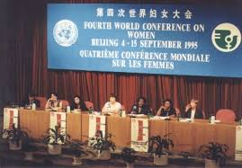
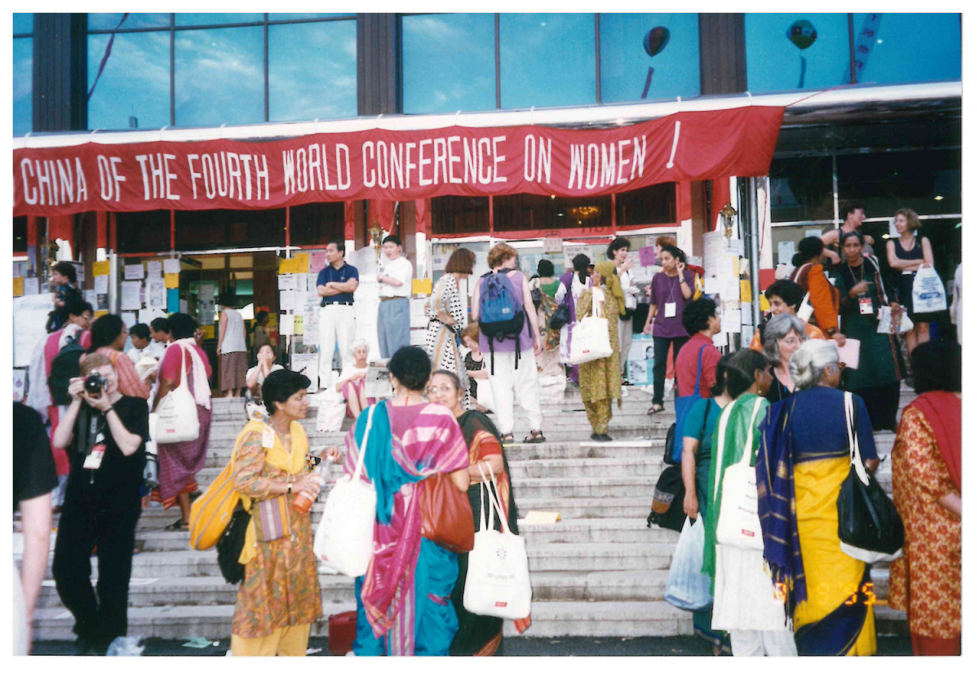
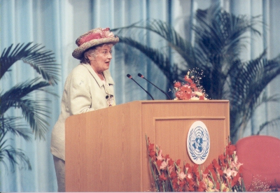
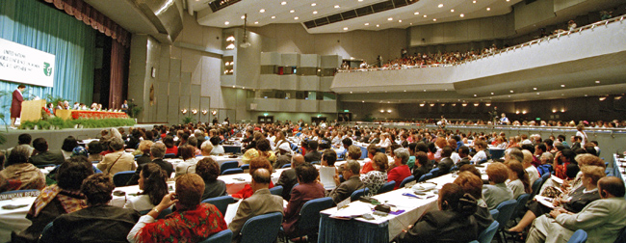
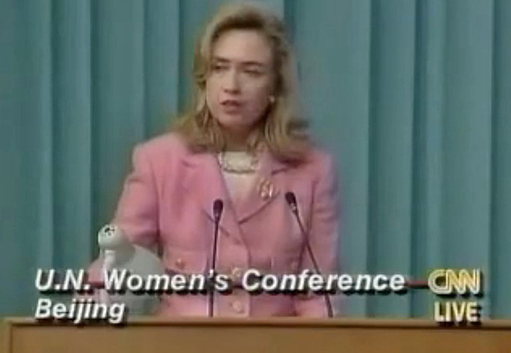
1995 Women’s Conference
1995年的世界妇女大会
WAFW.org

Slide 3
Women Worldwide
世界上的女性
Only 24.3% of members of National Parliaments are women;
国民议会议员中只有24.3％是女性；
Only 5% of Fortune 500 CEO’s are women;
《财富》 500强首席执行官中只有5％是女性；
Only 7% of top executives are women;
高管中只有7％是女性；
Only 10% of S&P’s top management are women;
标准普尔高层管理人员中只有10％是女性；
Only 19% of corporate board seats in S&Ps are women;
标准普尔公司董事会席位中只有19％的是女性；
Only 20% of the highest paid executives are women.
高薪高管中只有20％是女性。
WAFW.org

Slide 4
Women Worldwide
世界上的女性
1 in 4 girls will be born into poverty;
每四名女孩中就有一名出生在贫穷的家庭里
½ girls in developing countries do not enter high school;
在发展中国家，有一半的女孩没有机会接受高中教育
40.3 million victims of human trafficking globally; 75% are women and girls.
全球有403千万人遭遇人口贩卖，75%是女性。
1 in 3 women are victims of domestic violence;
每三名女性中就有一名是家庭暴力的受害者
60% of malnourished people are women;
60%的营养不良人口是女性
POVERTY
贫穷
MATERNAL HEALTH
母婴健康
WAFW.org

Slide 5
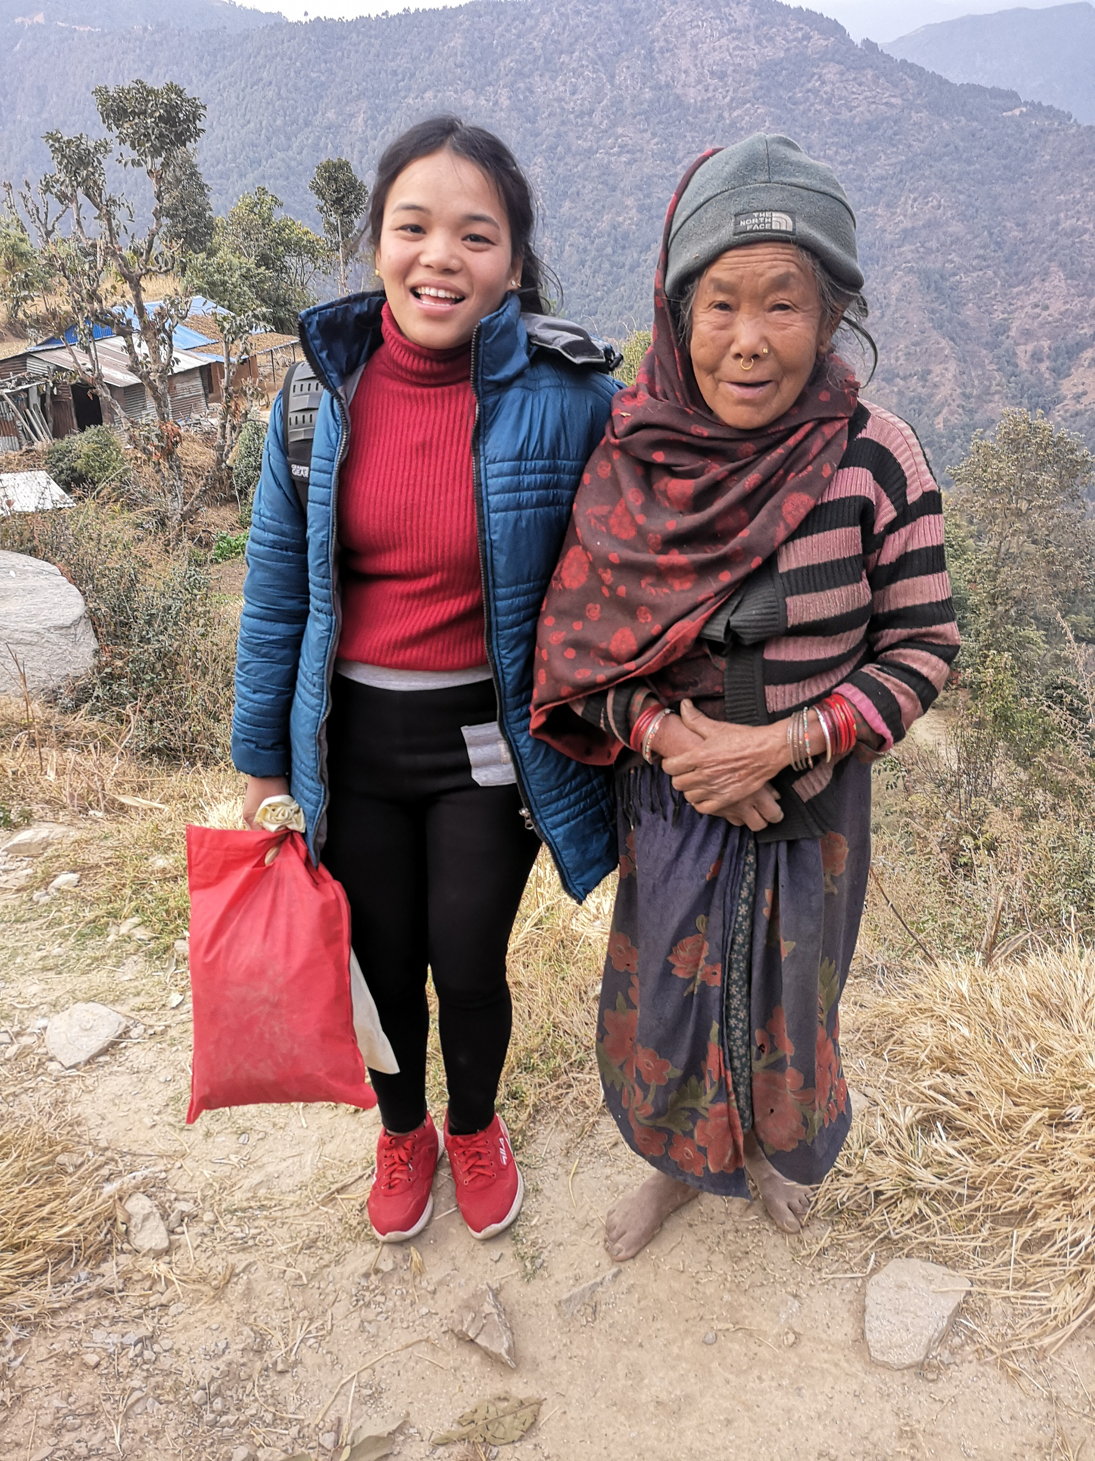
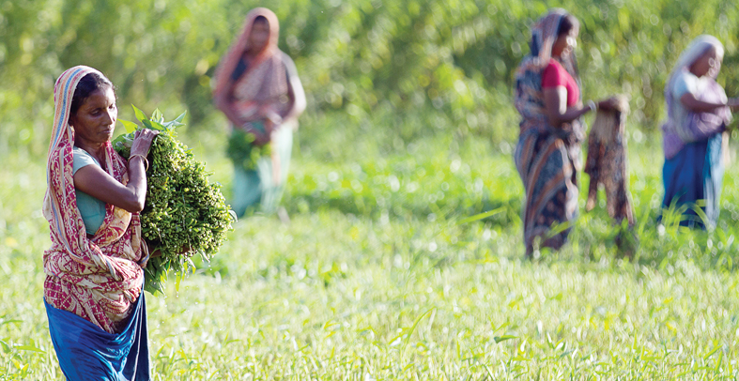
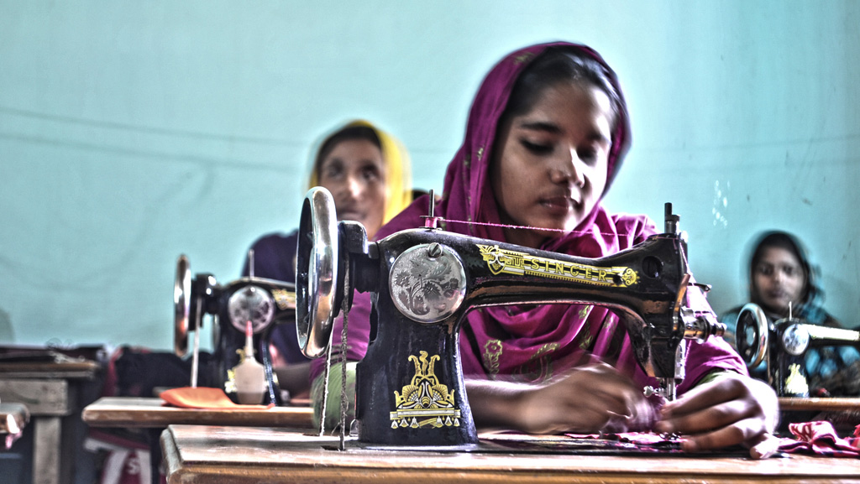
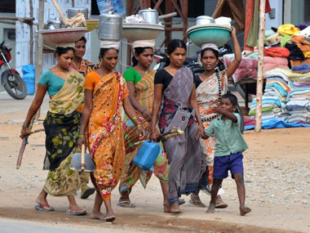
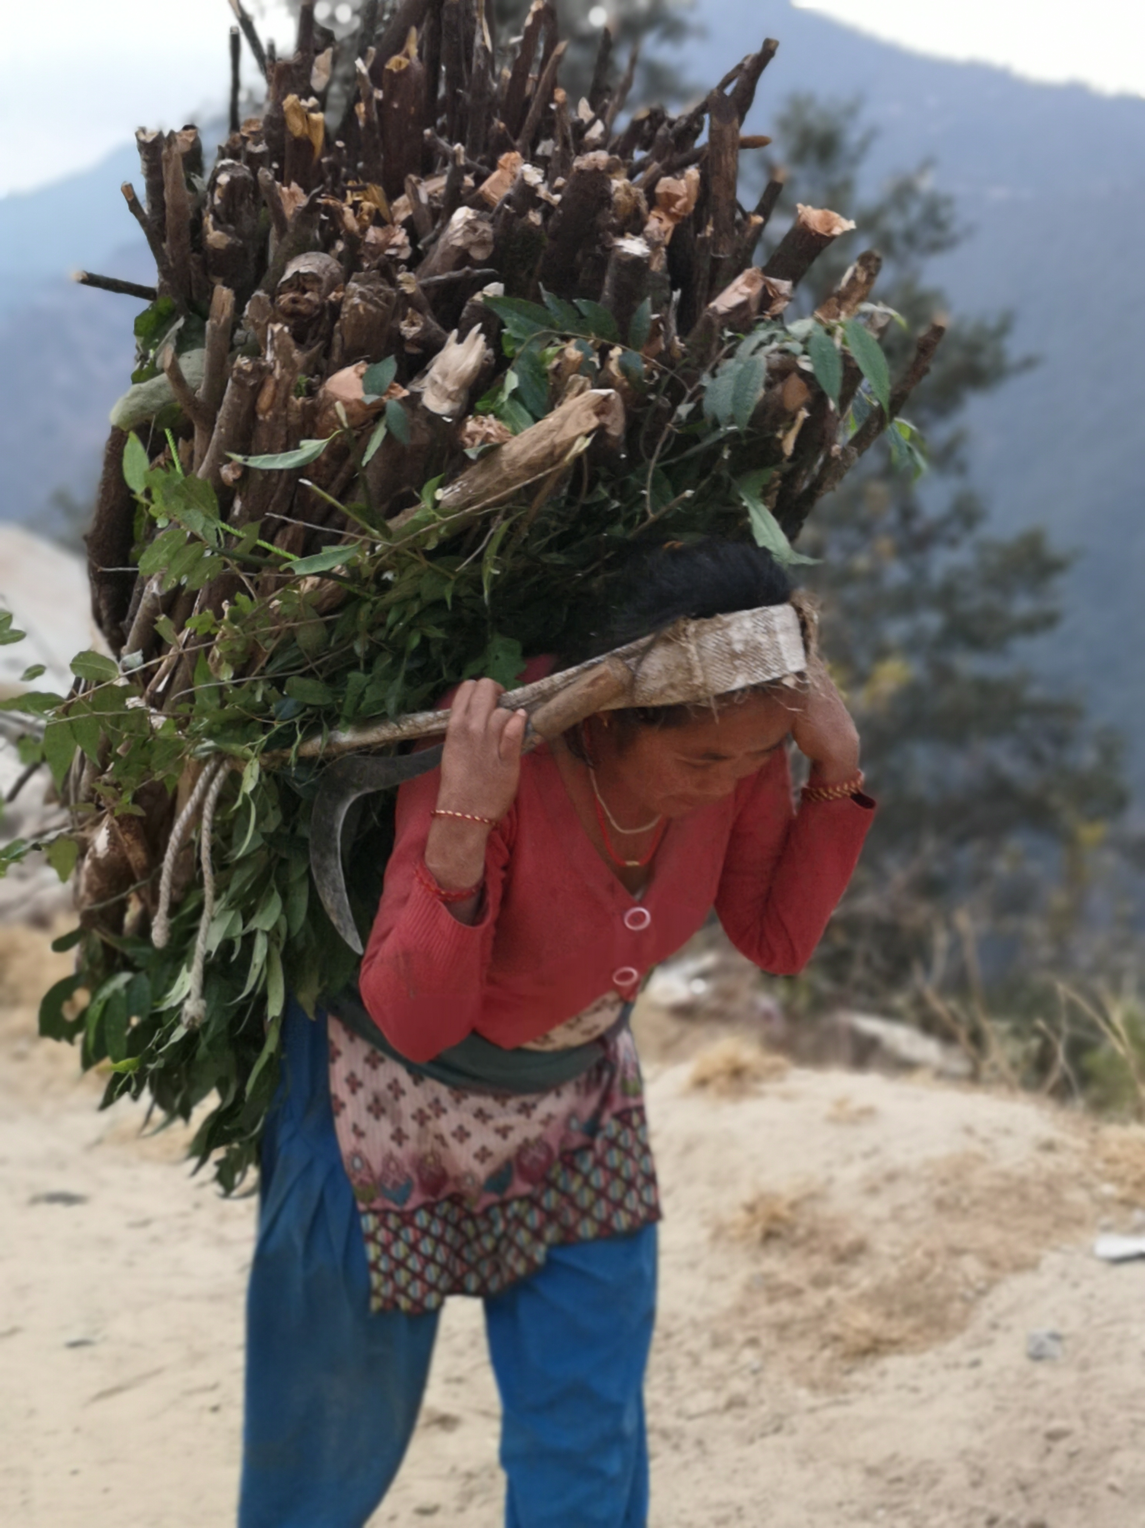
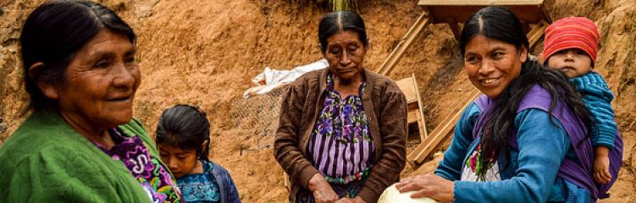
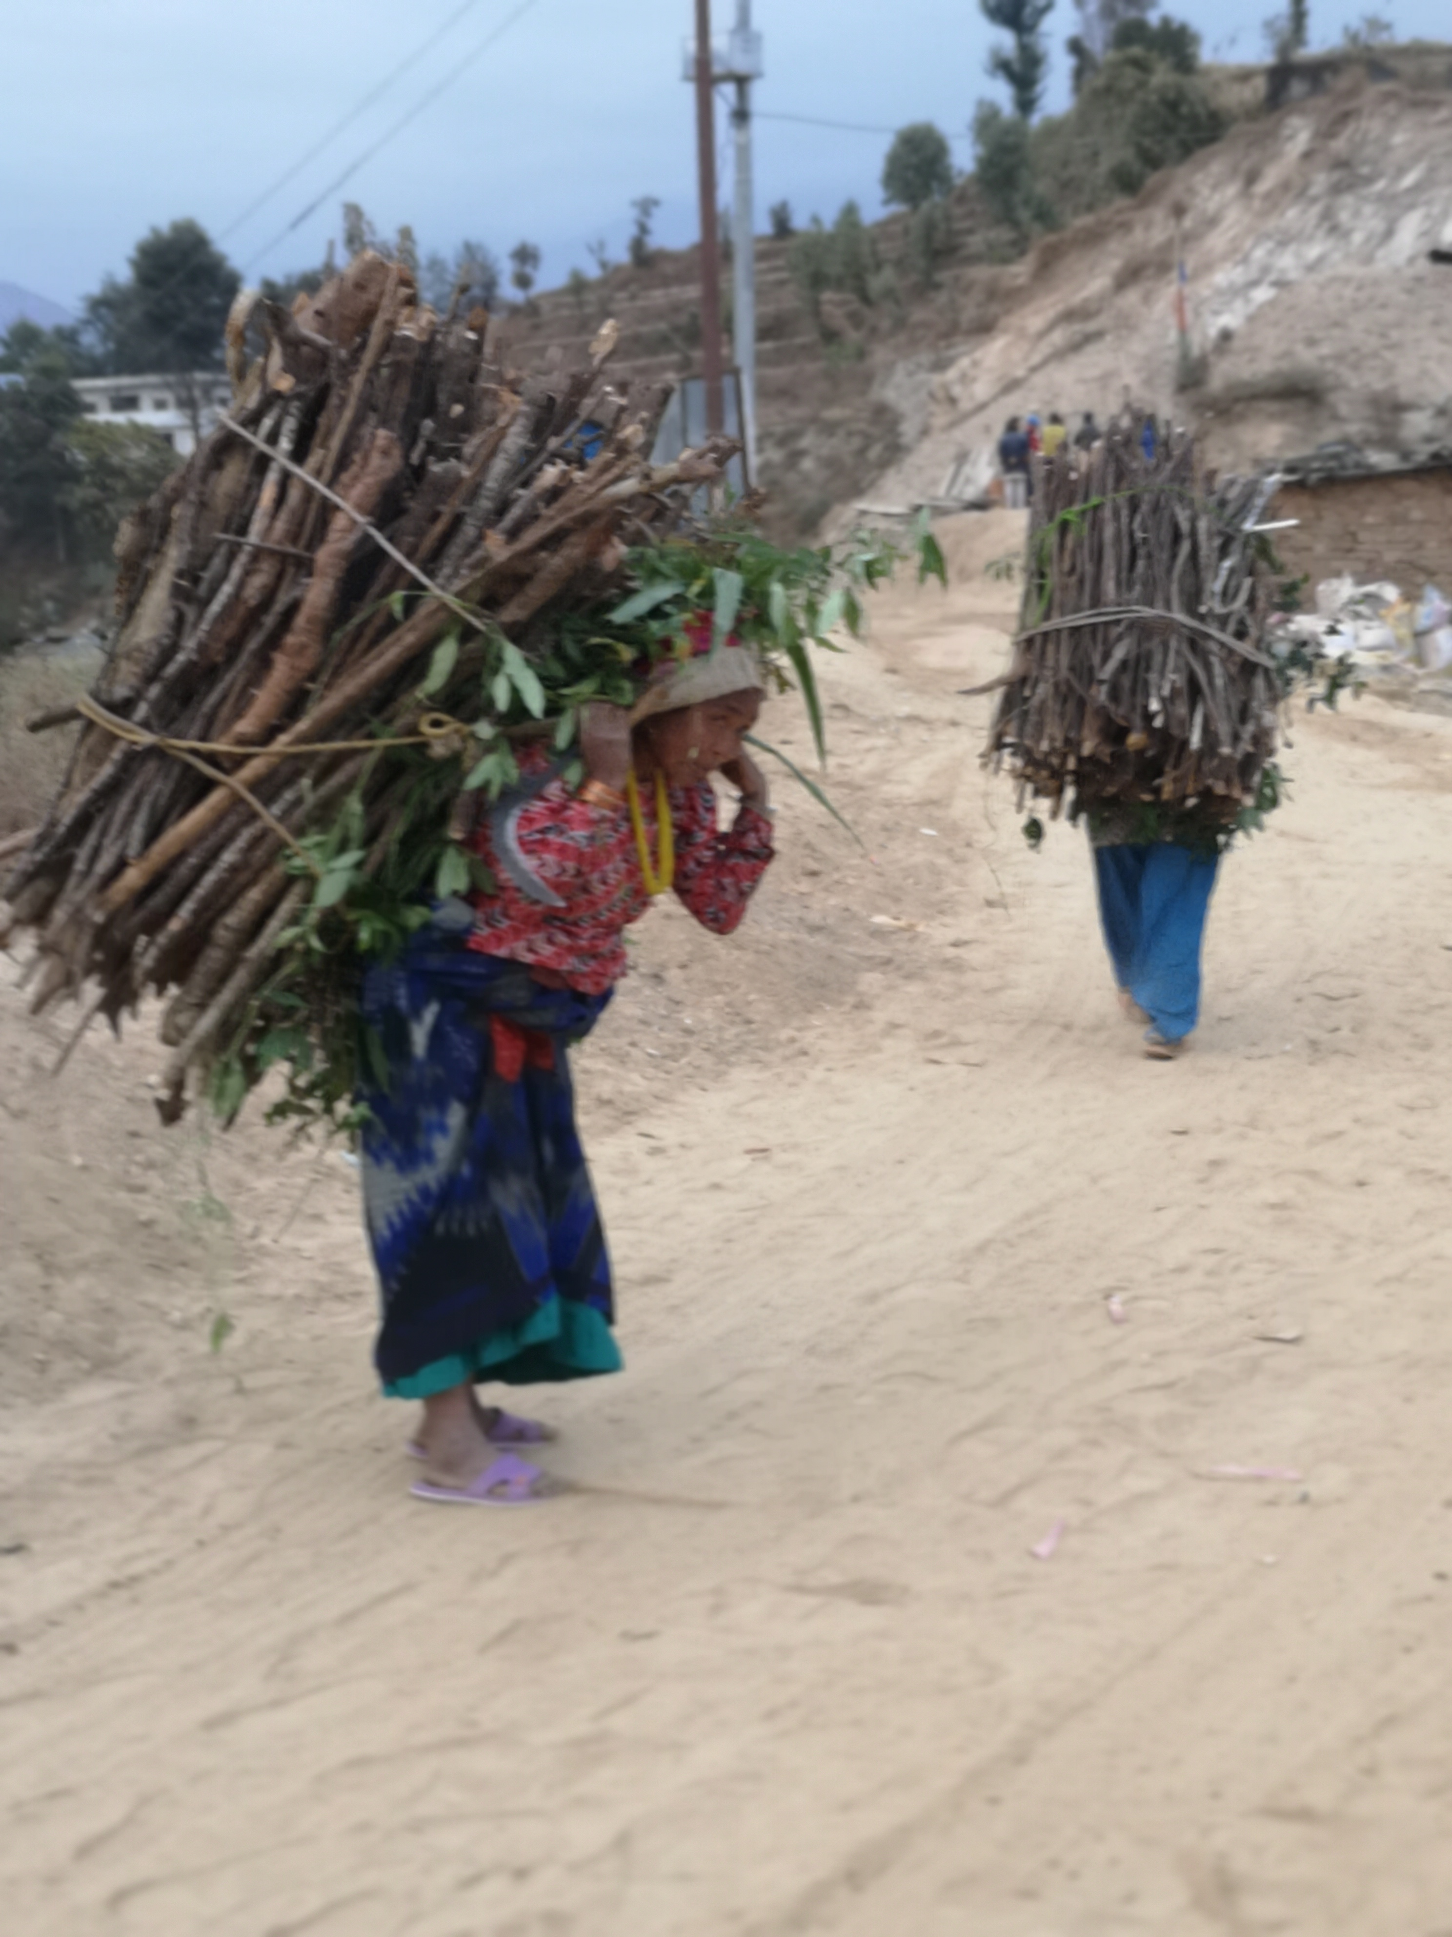
Women’s Working Conditions 女性的工作环境
WAFW.org

Slide 6
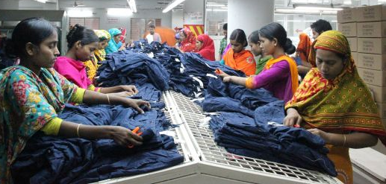
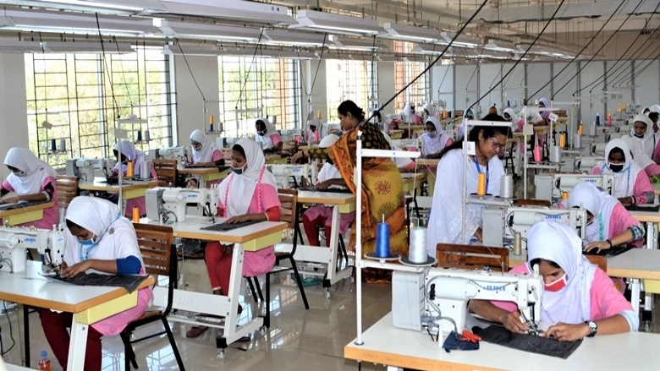
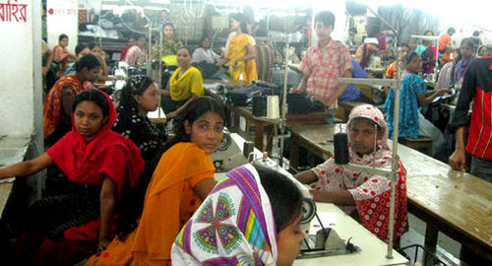
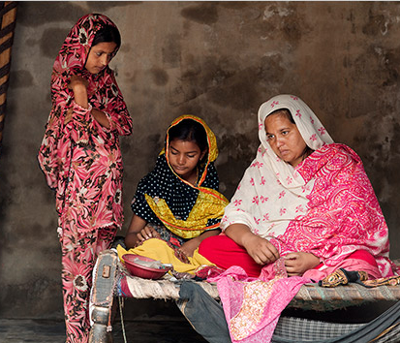
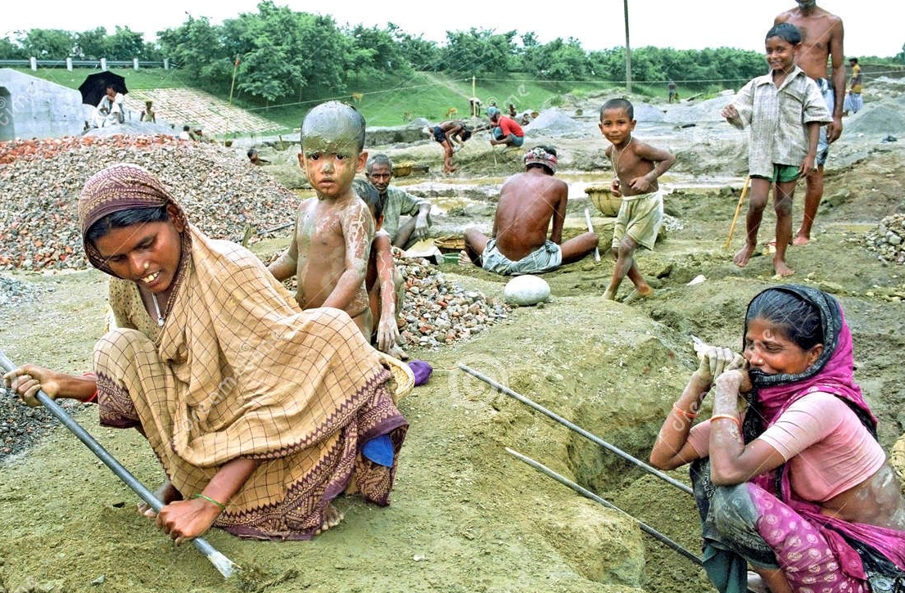
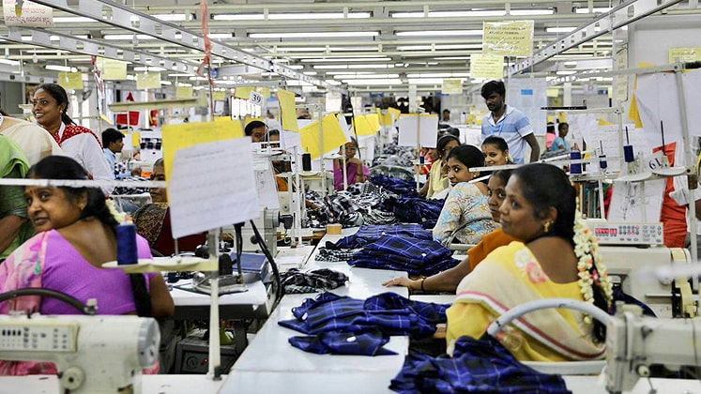
Women’s Working Conditions 女性的工作环境
WAFW.org

Slide 7
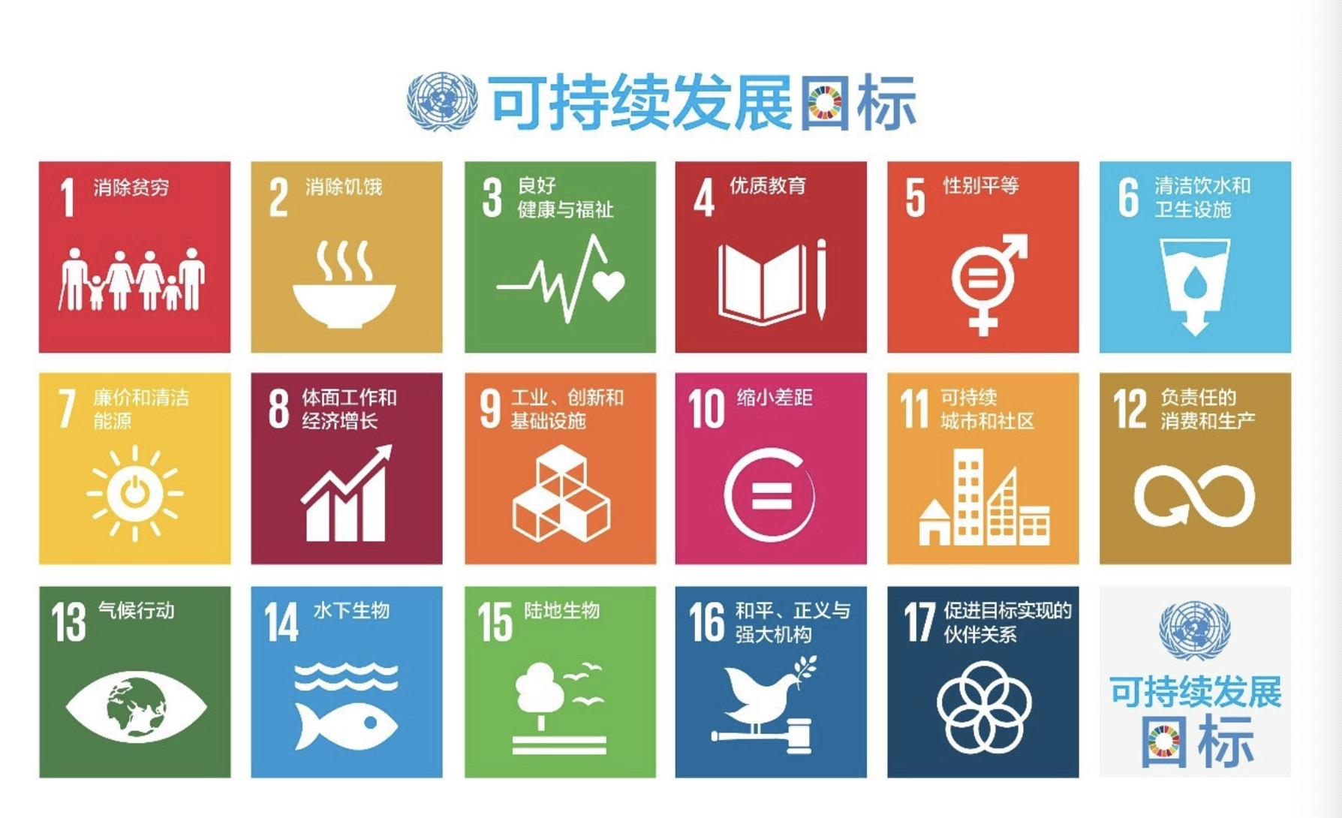
WAFW.org

Slide 8
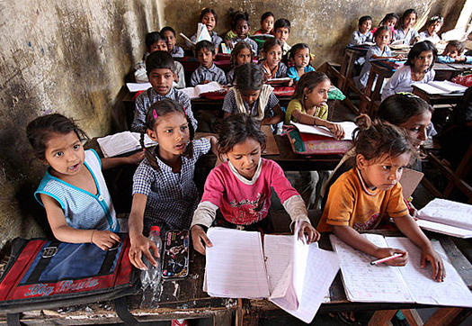
A document said “100 THINGS TO ENSURE THE ACHIEVEMENT OF THE UN SDG
有文章说“实现联合国可持续发展目标100事：
1. Educate girl children 让女孩接受教育
2. Prepare women for leadership roles 为女性担任领导职务作准备
THEN IT SAID….If you do number 1 and 2 you don’t have to do the other 98!
然后说，如果完成了前面两件事，那剩下的98件事都不用做了！”
EDUCATION
教育
WOMEN LEADERSHIP
女性领导
WAFW.org

Slide 9
These results the creation of WAFW 这就是女性学院产生的原因
The World Academy for the Future of Women is a
世界女性未来发展学院是一个
BOLD and DARING leadership program
大胆严谨的领导力培训项目
focused on developing
YOUNG WOMEN AND MEN
旨在培养年轻的女性和男性的领导力
for leadership roles that will address and achieve the
来提升世界女性的领导力
United Nations Sustainable Development Goals.
来解决和实现联合国可持续发展目标。
WAFW.org

Slide 10
World Academy for the Future of Women
世界女性未来发展学院
PURPOSE 学院目标
To advance and accelerate the leadership of women worldwide
促进和提升全球女性领导力
MISSION 学院使命
To empower women through the discovery of their passion, purpose, and path to success, calling forth the full expression of human possibilities through collaborative and inclusive partnerships
通过探索人生目标，激情和通往成功之路来鼓励女性，通过发展合作和包容的伙伴关系充分发掘个人潜能
WAFW.org

Slide 11
About World Academy
关于女性学院
The World Academy for the Future of Women is a program of Global Interactions begun on the campus of Sias International University. The partnership with Sias began in 2009 when University founder and chairman, Shawn Chen, and Jerrie Ueberle, former Sias Foundation Board President and founder of Global Interactions, a U.S. 501(C)(3), non-profit corporation, created a partnership to house the World Academy on Sias campus.
In August 2017, World Academy Nepal was began at Imadol,
Kathmandu.
In September 2018, World Academy Bangladesh was began at ULAB, Dhaka
世界女性未来发展学院是美国环球交流公司与郑州西亚斯学院合作的公益项目，始于2009年，由西亚斯国际学院的创始人兼理事长陈肖纯先生，与前西亚斯基金会主席及美国环球交流公司总裁杰瑞·尤伯利女士，共同商议决定将世界女性未来发展学院设立于西亚斯校园内。
2017年8月，女性学院尼泊尔分院成立于加德满都Orchid .
2018年9月，女性学院孟加拉分院成立于达卡ULAB。

Slide 12
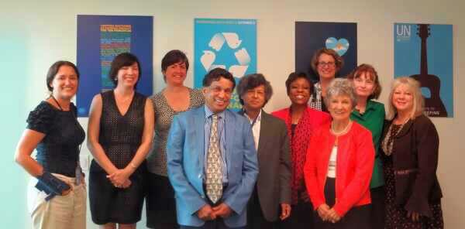
UN ASPIRE CHAPTER 联合国学术影响成员组织
In 2014, the World Academy for the Future of Women was recognized and awarded status as an ASPIRE chapter.
2014年，世界女性未来发展学院被认可并授权成为联合国学术影响的成员组织。
The student branch of UN Academic Impact is known as ASPIRE: Action by Students to Promote Innovation and Reform Through Education.
联合国学术影响是一项全球倡议。学术影响促成高等教育机构和联合国的合作，在共享的学术界社会责任文化中，通过活动和研究，进一步实现该机构的目标和使命。

Slide 13
WAFW Facilitators
学院导师
Women and men who come to Sias as World Academy Facilitator are committed to developing World Academy members to accelerate the leadership of women worldwide. Facilitators are volunteers who pay their travel costs to come to facilitate and donate their time and expertise to be on campus for five weeks to deliver their curriculum module.
The facilitators are individuals with leadership skills from business, corporations, community, NGO’s, and entrepreneurs. They each share a passion and commitment for preparing women for leadership roles, and men for supporting women in achieving gender equality.
世界女性未来发展学院的导师们来自全世界不同国家，教育界、商界、文化界等不同领域，每个人都有着丰富的人生阅历与卓越的领导力技能，导师们以志愿者的形式自己承担所有费用来到世界女性未来发展学院进行为期五周的授课，将自己的专业技能转化为培训课程，引导并激励新一代学生，他们拥有共同的激情与承诺，致力于提升和促进全球女性的领导力，帮助女性适应领导角色，帮助男性更好的支持女性以实现真正的男女平等。

Slide 14
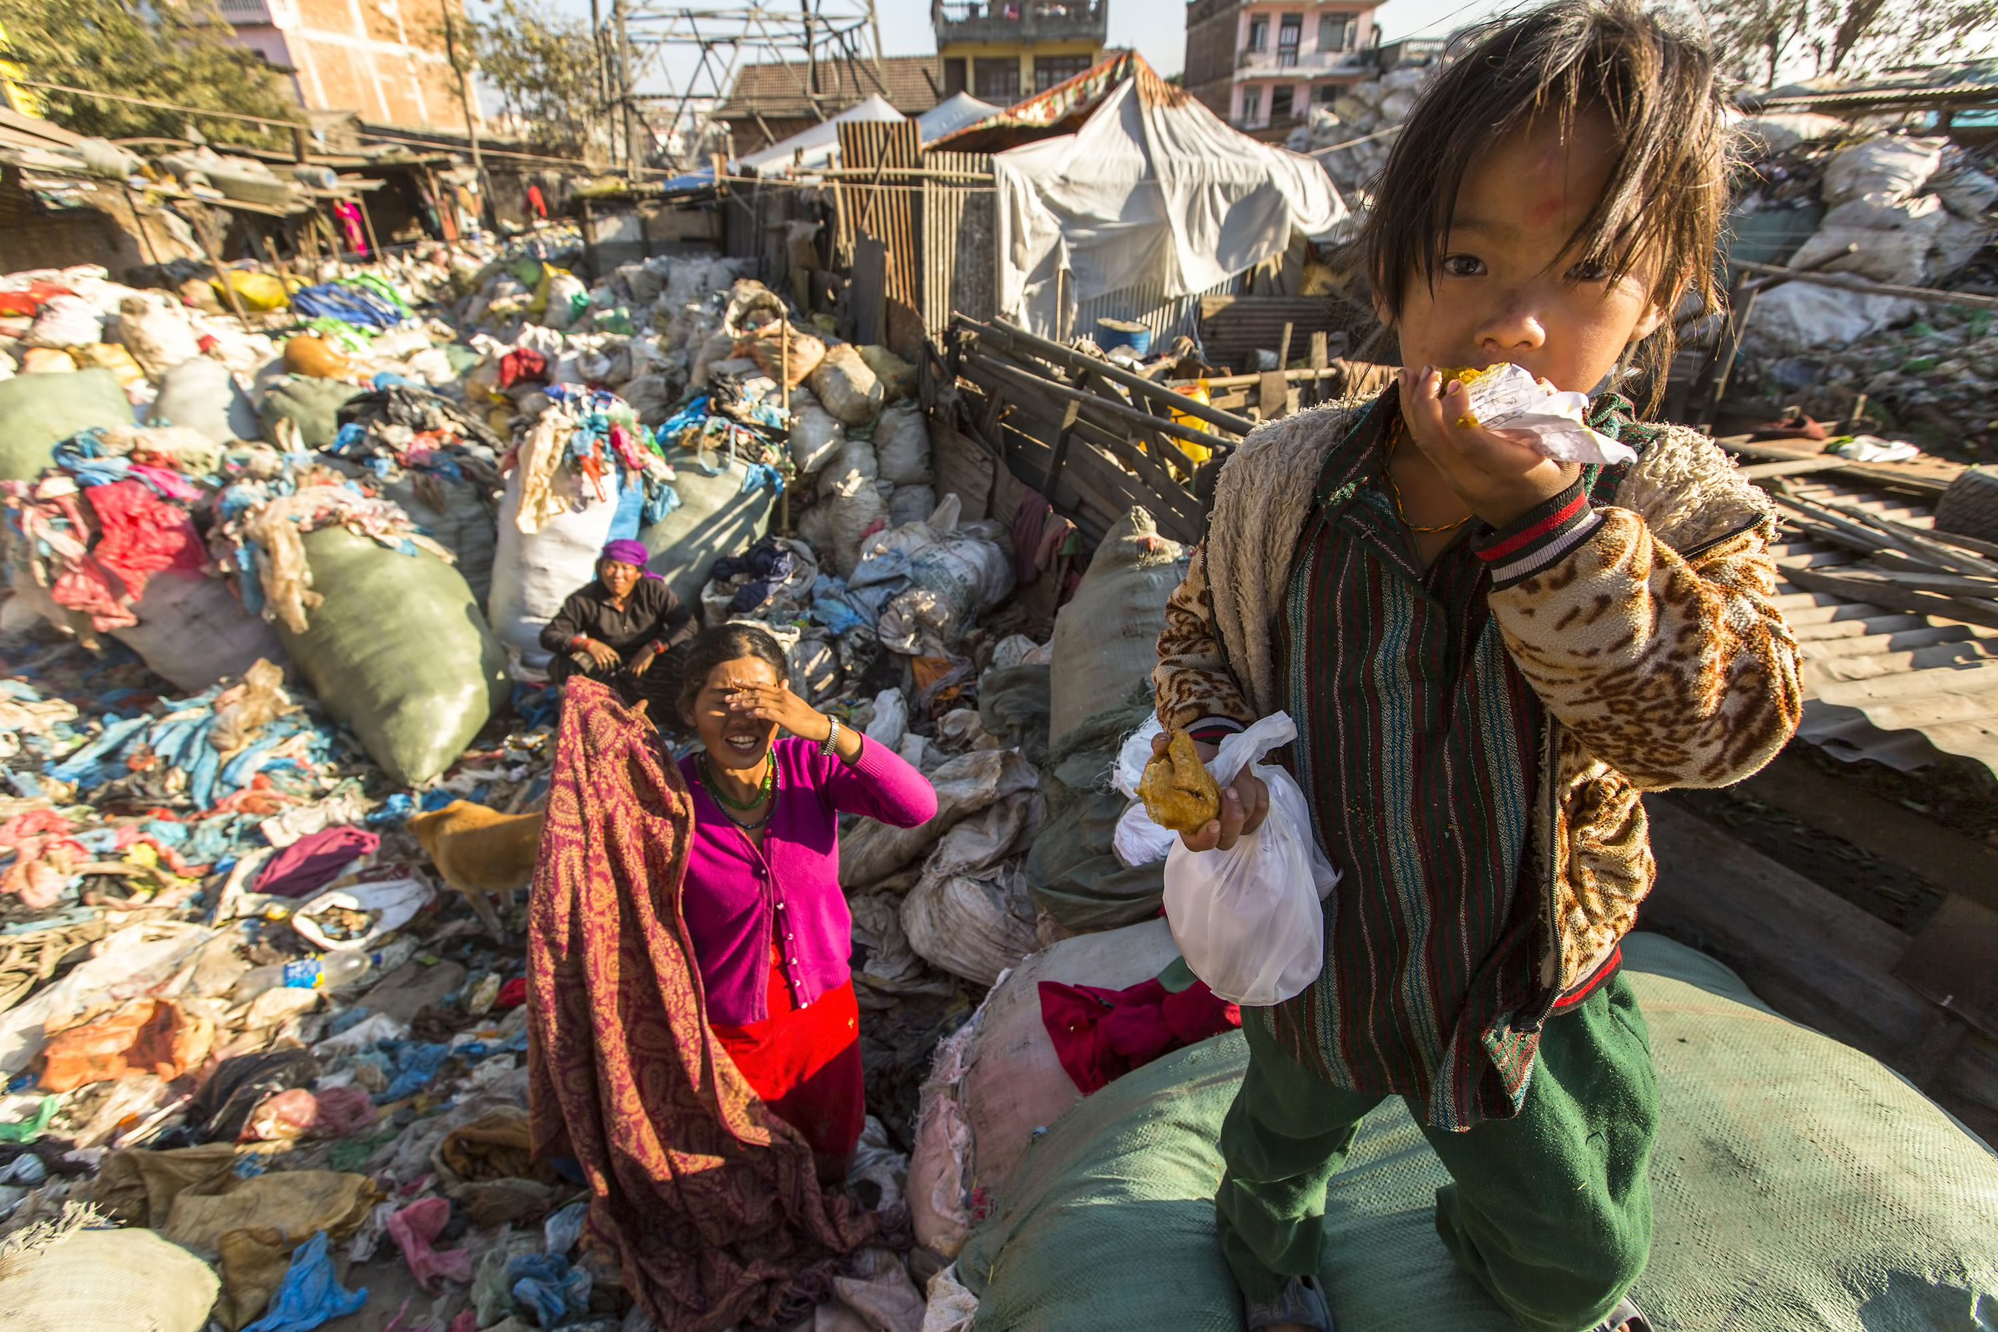
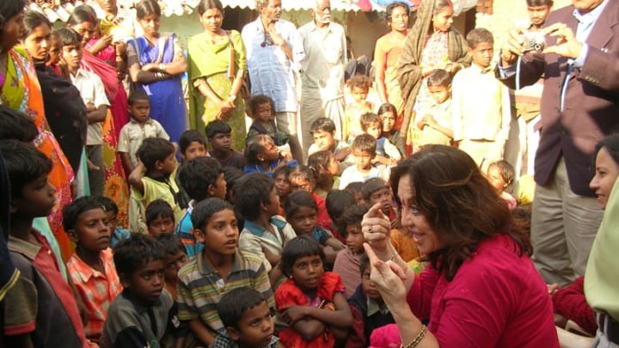
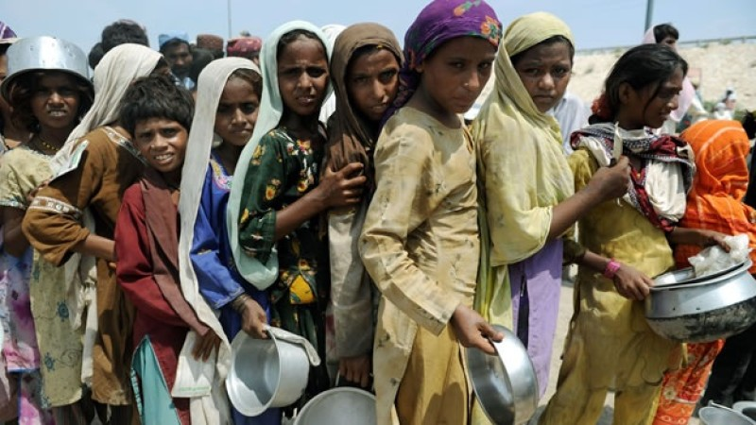
Conditions for many million women on the planet are UNNECESSARY and UNACCEPTABLE. World Academy members are Taking Knowledge to ACTION to address these basic social justice, gender equality and human dignity issues. 世界上有数以百晚计的女性的目前生活的状况还是不容乐观，也非常不必要的。世界女性未来发展学院的成员们将知识转换为行动，去改变基本的社会公正、男女平等和人类尊严。
World Academy for the Future of Women
世界女性未来发展学院
WAFW.org

Slide 15
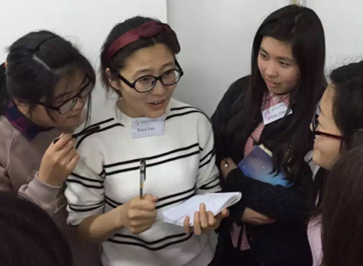
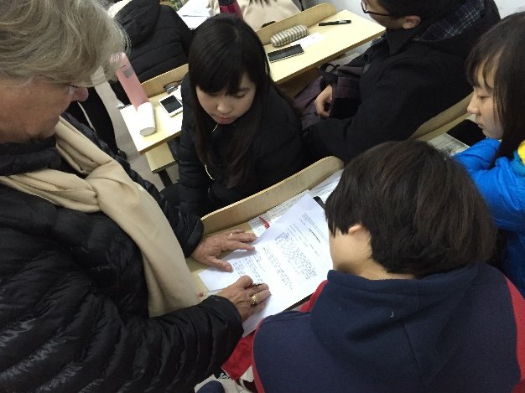
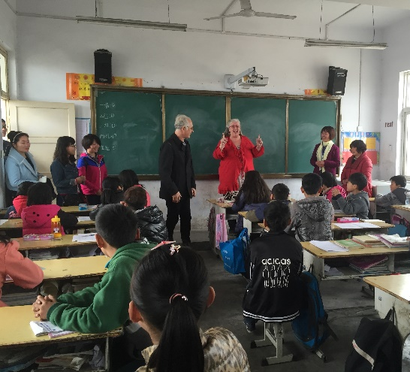
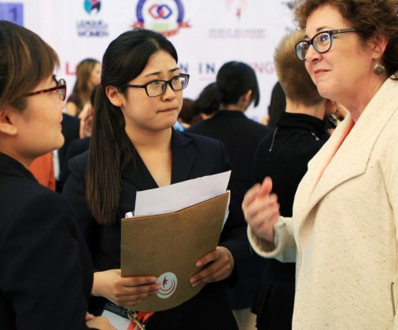
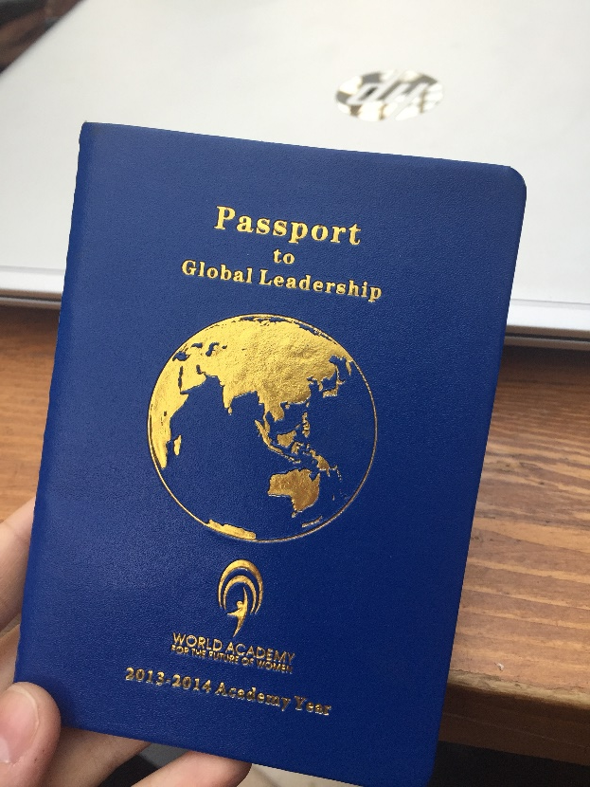
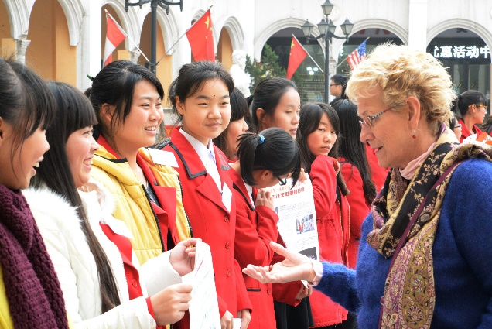
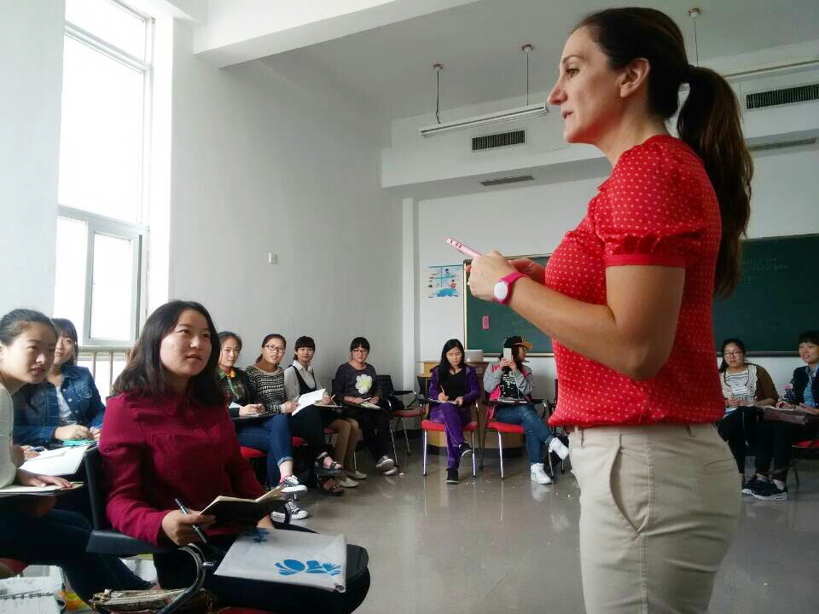
WAFW IN CHINA
世界女性未来发展学院-郑州西亚斯学院总院
WAFW.org
Notes:
To Jessie

Slide 16
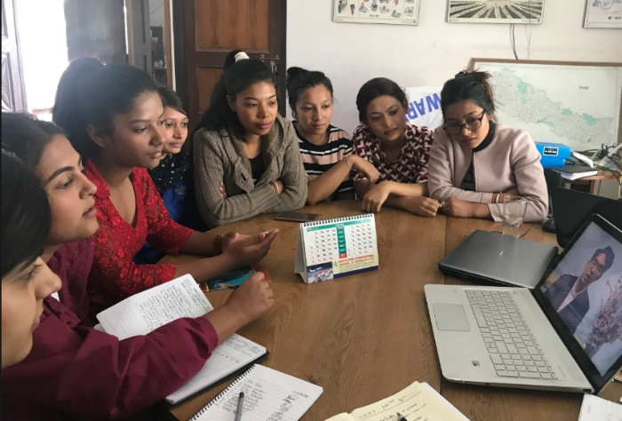
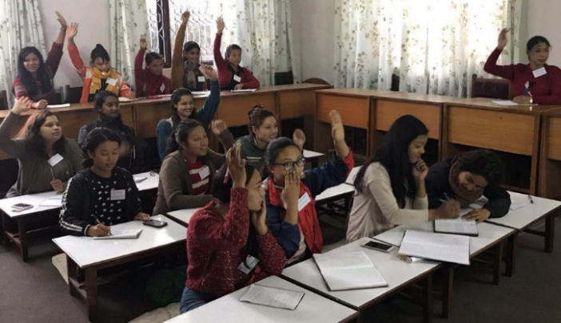
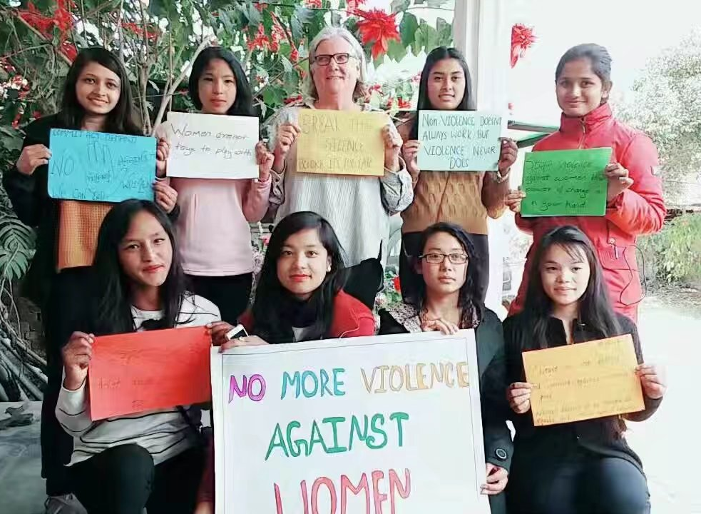
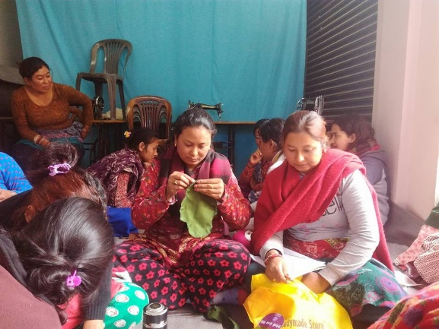
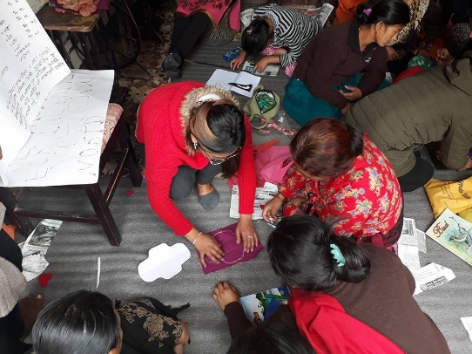
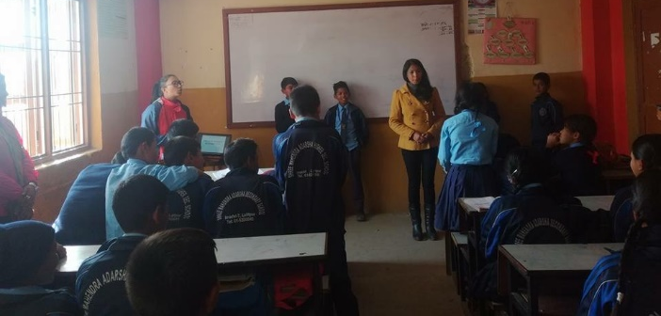
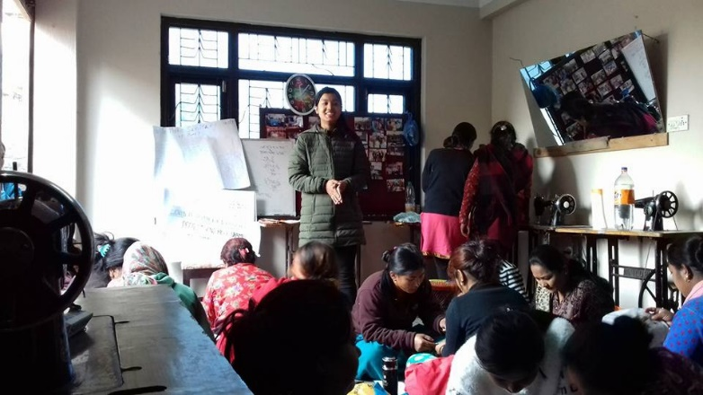
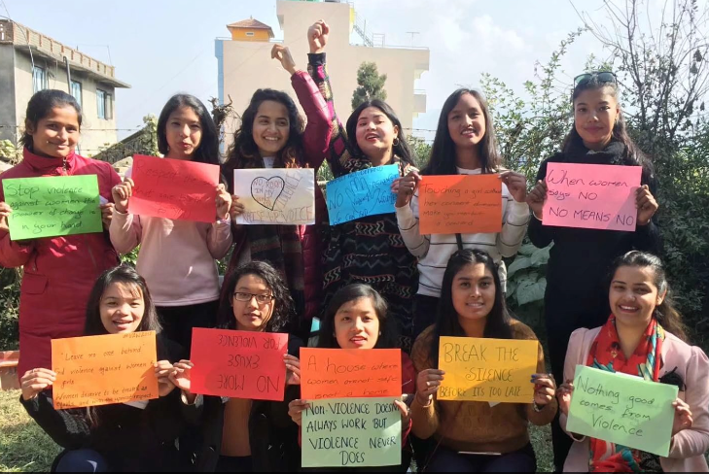
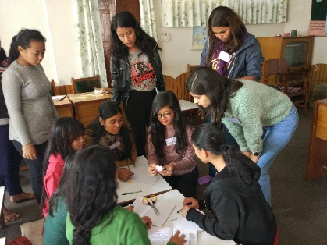
WAFW IN NEPAL
世界女性未来发展学院-尼泊尔分院
WAFW.org

Slide 17
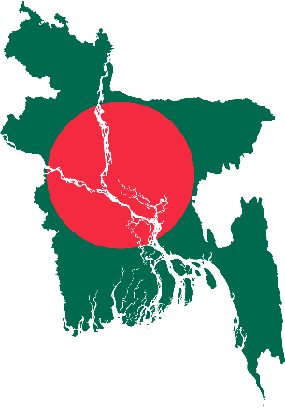
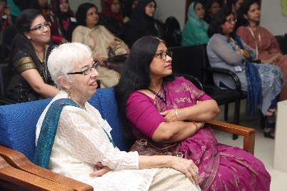
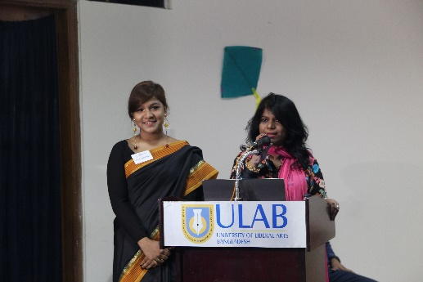
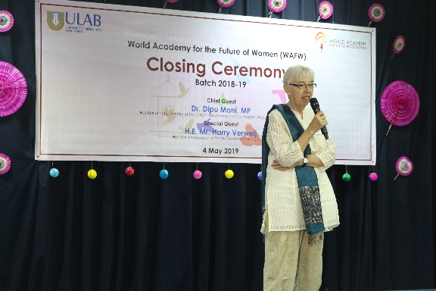
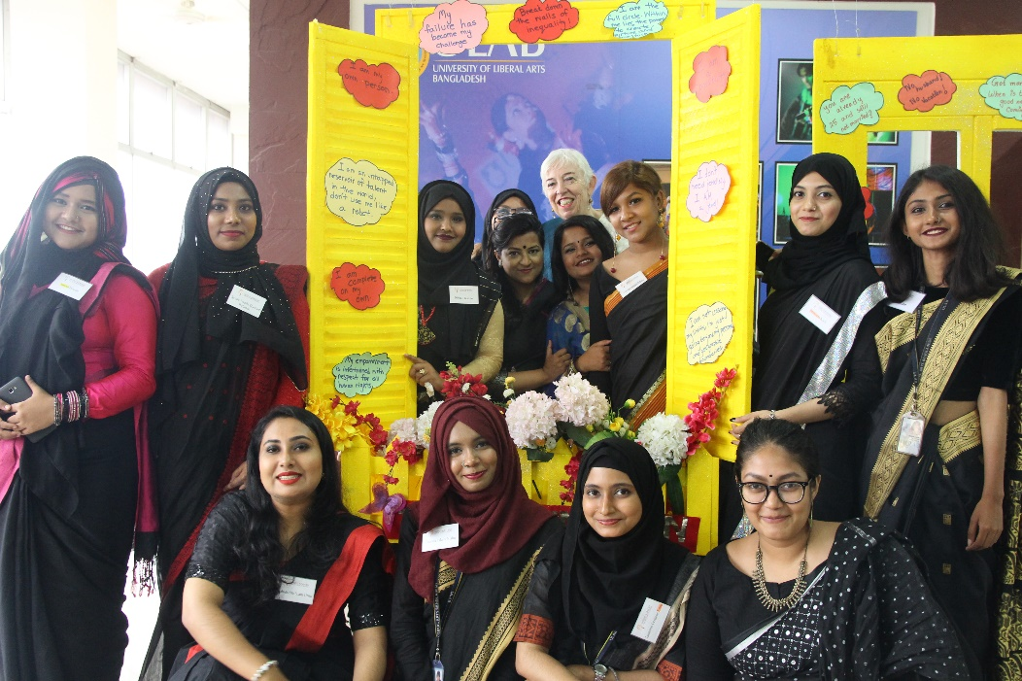
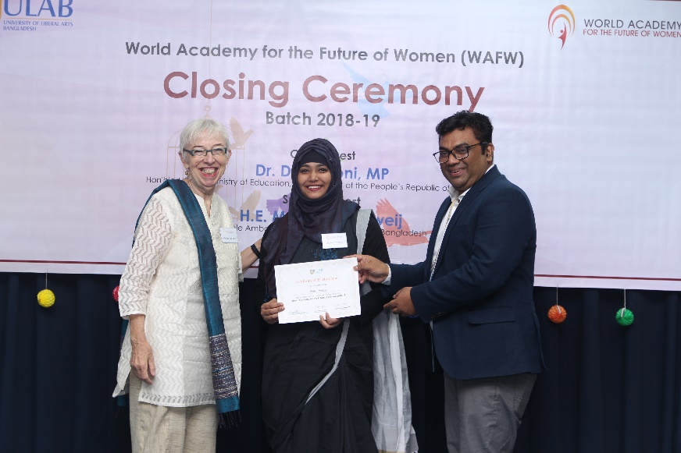
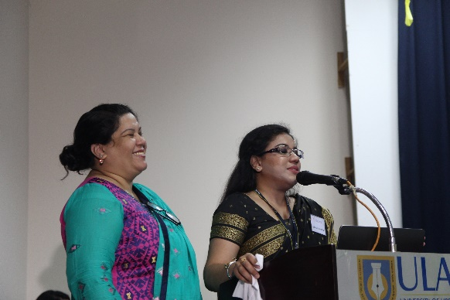
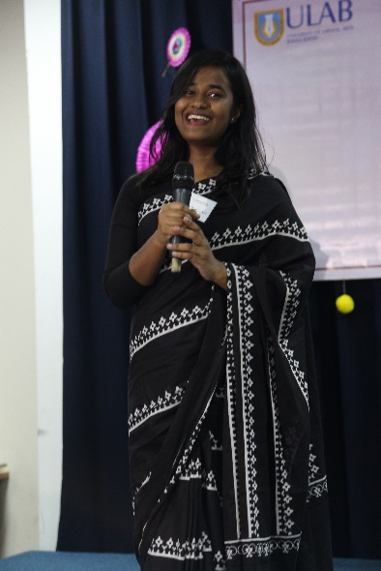
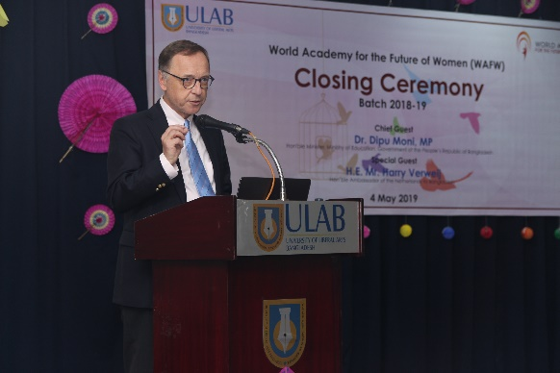
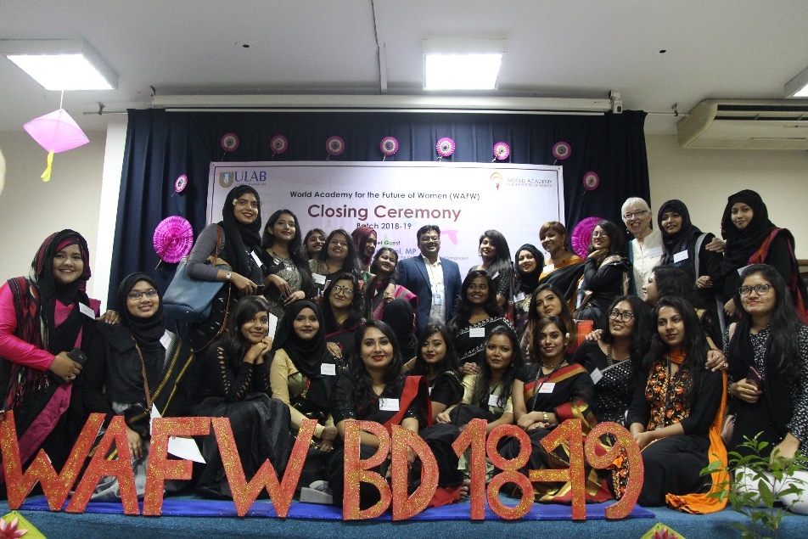
WAFW IN Bangladesh
世界女性未来发展学院-孟加拉国分院
WAFW.org

Slide 18
WAFW Projects
女性学院项目组
Sunshine Angels
阳光天使
One to One
一对一
Leaders of Tomorrow
明日小领袖
Literacy Project
阅读种子公益计划
Give Voice to Women
传递女性声音
Continuing Learning
继续学习
HIV/AIDS
HIV/AIDS Awareness
关注艾滋病
Nourishing Life
滋润生命
Warm Hearts
温暖的心
Green Sias
绿色西亚斯
WAFW.org

Slide 19
WAFW Projects
学院项目组
Sunshine Angels 阳光天使
To promote the educational and social development of children with disabilities
特殊儿童（智障、聋哑）教育,定期拜访特殊教育学院
One to One 一对一
To match university students with children who have been left-behind in their villages with grandparents or in a residential school when their parents have left their villages to work in other cities or provinces.
关爱留守儿童，建立西亚斯大学生与留守儿童一对一帮助辅导关系
Leaders of Tomorrow 明日小领袖
To create exciting educational experiences for children attending migrant schools.
与西亚斯外籍教师群体合作，通过完整的世界文化课程设置，引导帮助进城务工农民工子女打破自我局限并开拓眼界。

Slide 20
WAFW Projects
学院项目组
Literacy Project 阅读种子公益计划
To encourage parents to read to, and with their children on a regular basis.
鼓励亲子阅读，让家长多去关注孩子们的阅读，并以此去引导和影响他们，帮助孩子们在童年养成好的阅读习惯
Give Voice to Women 传递女性声音
Advocates for women to pursue their dreams and achieve equality in their home, community, and work place
采访各领域不同背景女性，以鼓励其为更多女性的成长而努力
Continuing Learning 继续学习
To encourage the young women workers at Foxconn to continue learning, discover their dreams, and open their eyes to know they have endless possibilities.
鼓励富士康工厂女工继续学习，发掘自身潜力与可能性

Slide 21
WAFW Projects
学院项目组
Green Sias 绿色西亚斯
Educates students, faculty and the local community members about environmental issues.
环保从身边做起，在校园内进行的环境保护与可持续发展活动
Big Bang Thinking 思维大爆炸
To solve problems for all the projects in the World Academy
创造性思维和批判性思维解决研究探讨问题最佳解决方案，为各项目活动提供支持
Taking Care of Business 打理生意
Teaches the value and necessity of generating money
了解筹集资金的价值与必要性

Slide 22
Call for Action 行动起来！
The task is large. 任重道远。
The importance is urgent. 迫在眉睫。 The need for engagement and action at all levels can produce the impact and create the future we know is possible. 我们需要团结和凝聚各个阶层的人们行动起来，才能影响和创造我们可实现的未来。
This is a Call for Action.
行动起来。
A Call for Leadership
展现领导力
A Call for Support and Join the World Academy
呼吁支持和加入世界女性未来发展学院
WAFW.org

Slide 23
World Academy Partners and Sponsors
学院合作伙伴与赞助商
Powerful relationships have developed through the interactions that have occurred with businesses and organizations. These have led to meaningful dialogue and actions that have been mutually beneficial to the work of the World Academy to accelerate women’s leadership worldwide. These relationships have resulted in connecting our Academy members and Academy projects with individuals and groups who are aligned to promote gender equality, social justice, and human rights and improve the quality of life for others. Collaborative partnerships are essential to accelerate and achieve the United Nations Sustainable Goals.
我们被与众多企业和组织深度发展的关系激励着，在这种合作伙伴关系的引导下所进行的意义深刻的对话与活动对促进女性领导力的全球化这一工作受益良多。这些关系的展现是将学院成员和学院项目组同多个个人和集体联系起来成为联盟来推动两性平等，社会公正和改善他人生活质量。合作伙伴们高效的在促进我们目标的实现。

Slide 24
WAFW Partners and Sponsors
学院合作伙伴与赞助商
25

Slide 25
Thanks for Your Attention!
谢谢！
Jerrie Ueberle
Web: www.wafw.org
E-Mail: jerrie@globalinteractions.org

