Slide 1
World Academy for the Future of Women
Web: www.wafw.org
E-Mail: jerrie@globalinteractions.org
Phoenix, Arizona, USA
About the WAFW
March, 2020

Slide 2
Purpose
To Discuss Possibilities for
World Academy Acceleration and Sustainability

Slide 3
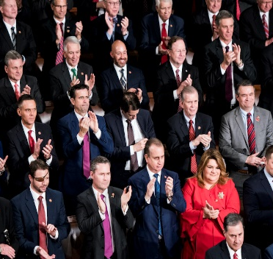
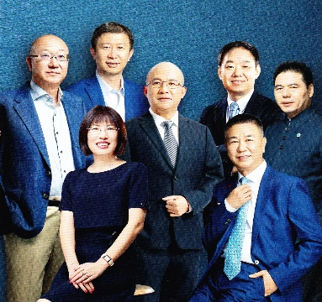
Status of Women Worldwide
POVERTY
1 in 4 girls will be born into poverty
50% girls in developing countries do not enter high school
40.3 million victims of human trafficking globally; 75% are women and girls
1 in 3 women are victims of domestic violence
60% of malnourished people are women
Only 5% of Fortune 500 CEO’s are women
Only 24.3% of members of National Parliaments are women
Only 7% of top executives are women
Only 10% of S&P’s top management are women
Only 19% of corporate board seats in S&Ps are women
Only 20% of the highest paid executives are women
ABUSE
HUNGER
CEO
EXECUTIVE

Slide 4
What Makes WAFW Unique
We believe there are adequate resources to achieve the UN SDGs. Accelerating women’s leadership worldwide will enable
Social Justice, Gender Equality and Human Dignity
for all.

Slide 5
Purpose & Mission
Purpose
To advance and accelerate the leadership of women worldwide
Mission
To empower women through the discovery of their passion, purpose, and path to success, calling forth the full expression of human possibilities through collaborative and inclusive partnerships

Slide 6
WAFW Operational Model
Alumni
Maintain Relationships and Continue to Innovate, Grow and Lead
Universities
Provide Accommodations, Classrooms, & Transportation
WAFW
Provides Curriculum Design, Curriculum & Education
Sign Memorandum of Understanding
Members
Inspired Students Who Apply, Interview and Engage Fully in A Year Long Academy Program. Tuition Free and No Credit
Facilitators
Trained Volunteers to Deliver A 5 Week Curriculum and Training
Attend Introduction and Orientation

Slide 7
WAFW Curriculum Model
Action Leadership Program
Interactive Labs
WAFW Projects
Open Forum
Seminars
Coaching
Text Here
Text Here
Text Here
Easy to change colors.
Easy to change colors.
Easy to change colors.
Content
Taking Content to Action
Clarification, Alignment and Acceleration
Member designed and implemented projects that reach into their campus, community and country to address a UN SDG
Introducing Other Students to Leadership and the WAFW Principles and Projects Based on UN SDGs

Slide 8
WAFW Timeline
Men’s Academy Began.
26 University Men Members.
WAFW Nepal Began in Imadol Community Learning Center Kathmandu.
2009
2011
2017
WAFW China Founded at Sias University at 3rd Women’s Symposium.
100 University Women Members.
WAFW Nepal moved to Southwestern State College.
Possible WAFWs in Brazil, Puerto Rico, Kenya…
2018
2020
2019
WAFW Nepal moved to Orchid International College, Kathmandu.
WAFW Bangladesh Began at the University of Liberal Arts Bangladesh, Dhaka.
13th Women’s Symposium held with 10,000 Participants.
WAFW 10 Years Anniversary

Slide 9
WAFW Powerful Outcomes
Academy China members from Villages
1
Facilitator Served
5 times
60%
1100+
200
162
Deployed from 5 Countries
Masters Degrees
Facilitators Trained
And
Relationship
Alumni
7
PhDs
Careers
14
Facilitators Served
3 times
Facilitators Served
2 times

Slide 10
WAFW Alumni

Slide 11
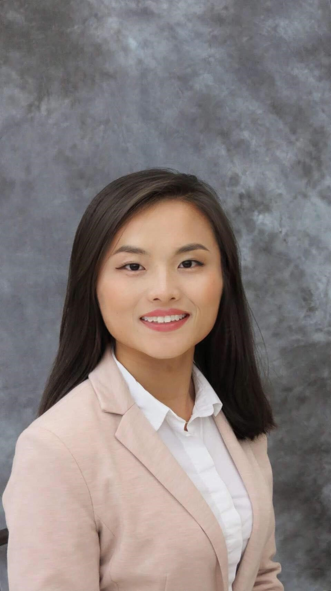
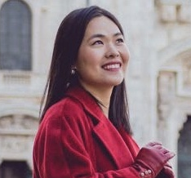
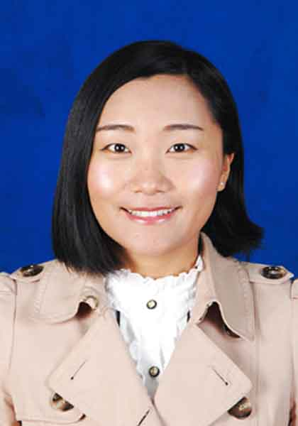
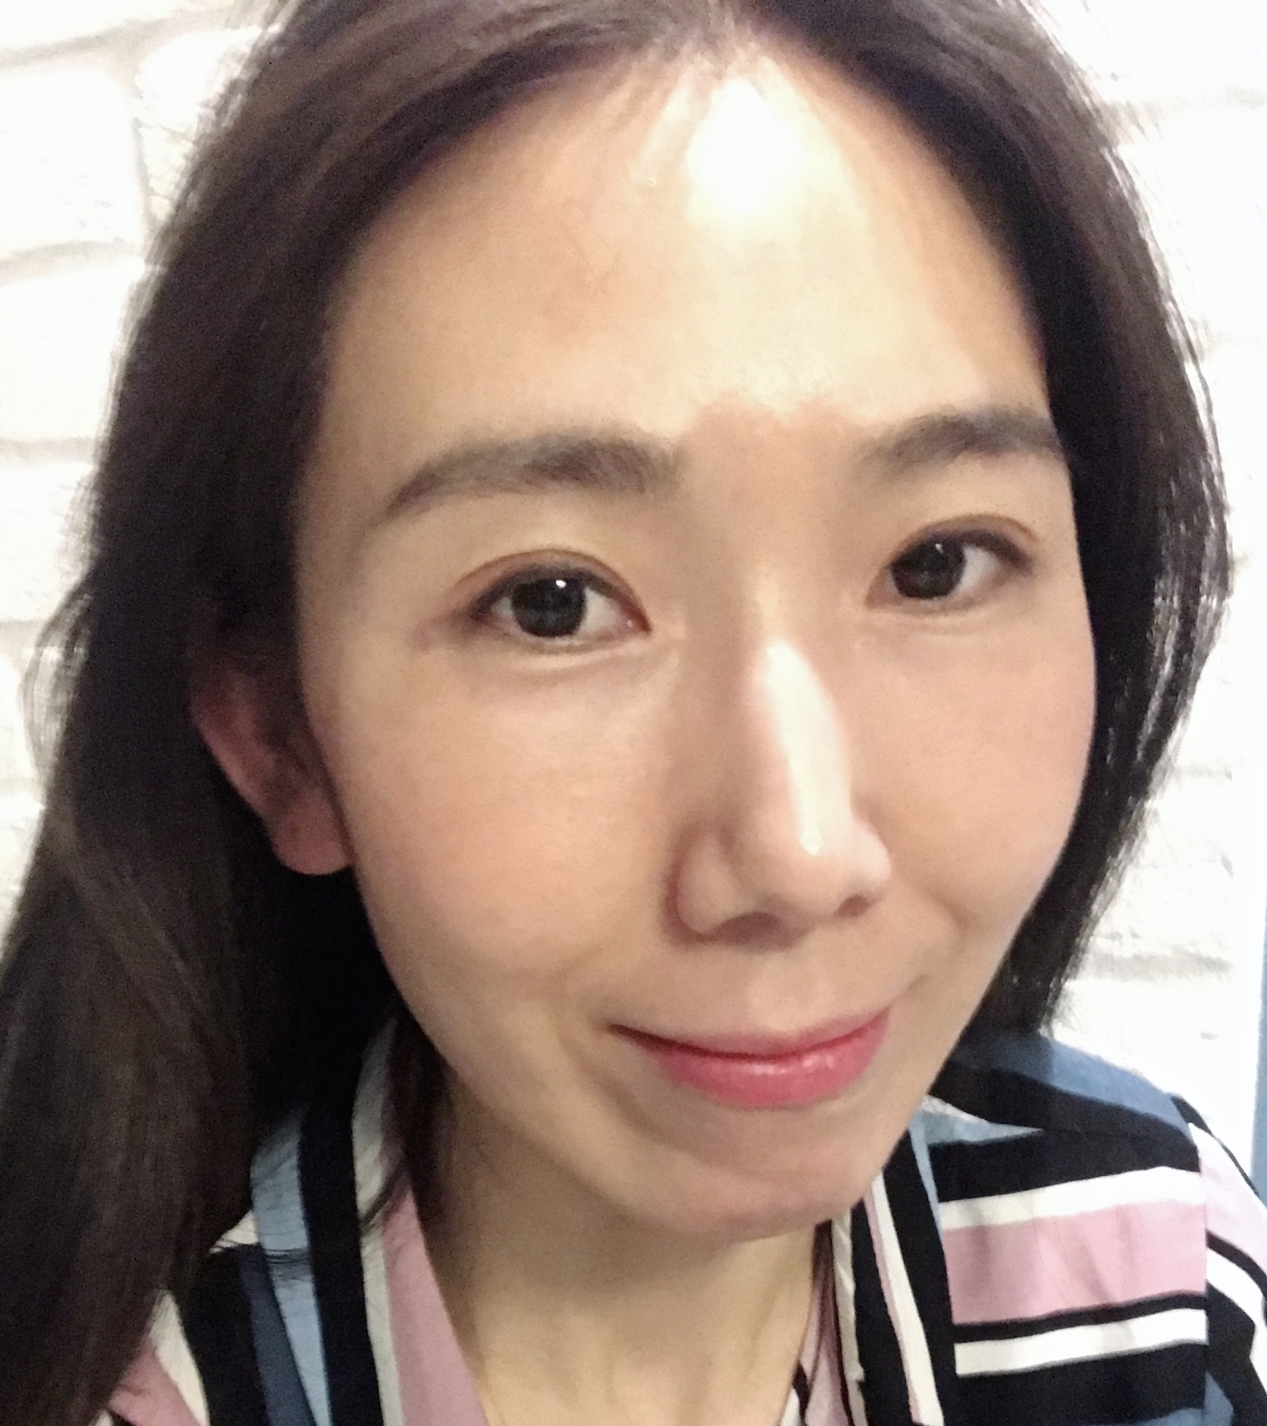
WAFW Alumni
Selia Wang, 2011
Florida State University, UAS
PhD
Taylor Zhang, 2012
Florida Atlantic Univeristy, USA Masters
Aptar Group
Tina Ren, 2009
Visiting Ph.D. student at Lund University, Sweden.
Graduate School of Chinese Academy of Social Sciences, China
Ph.D. Candidate
Agatha Zhao
Brigham Young University, USA
Masters
Acqua Shui, 2010
UN Peacekeeper in South Sudan
University of Warsaw, Poland, University of Haifa, Israel
Masters

Slide 12
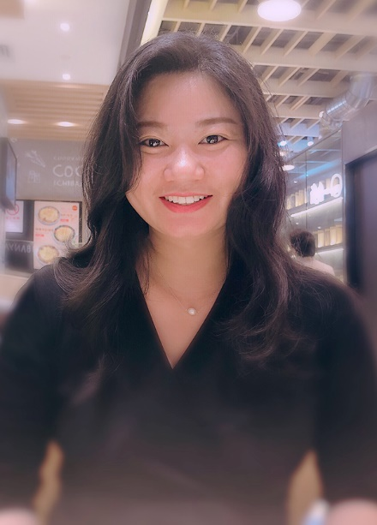
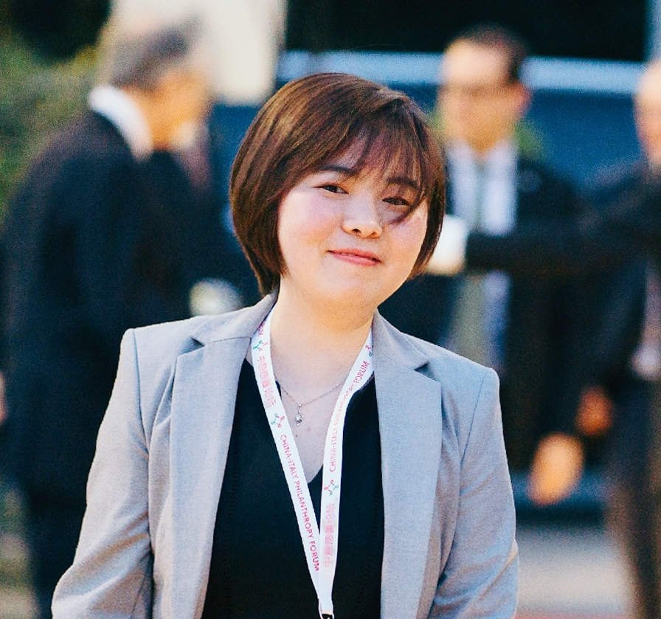
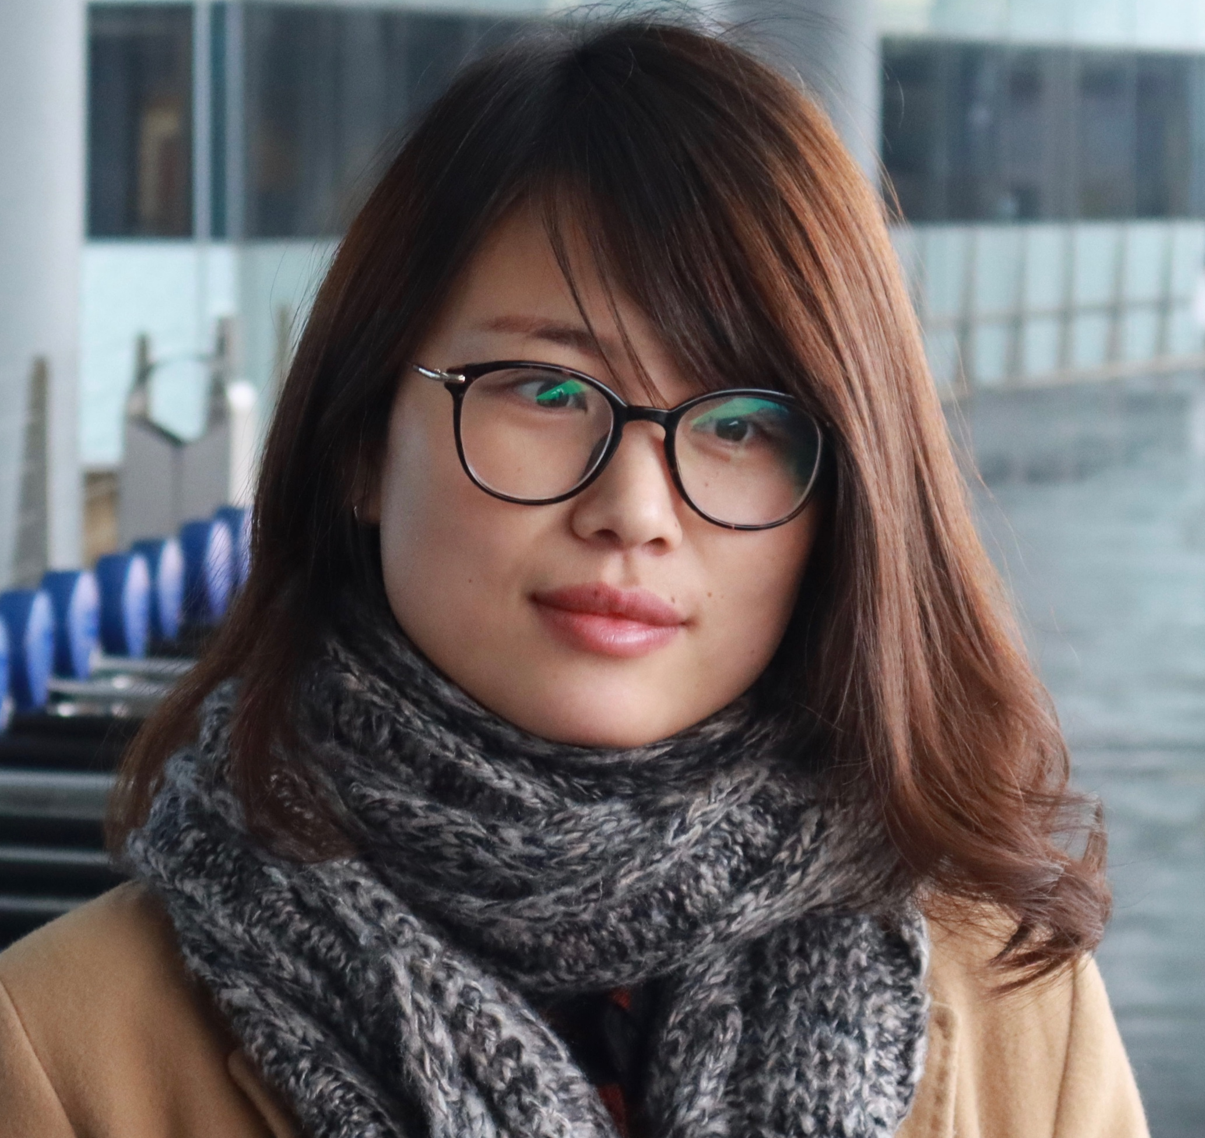
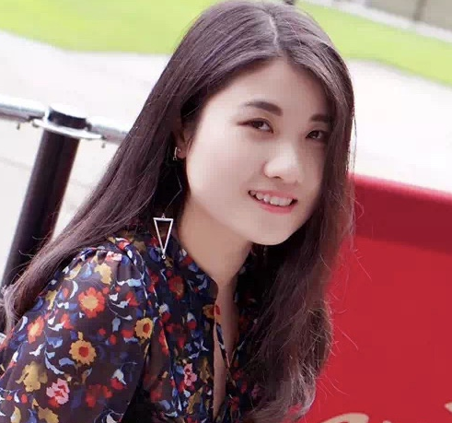
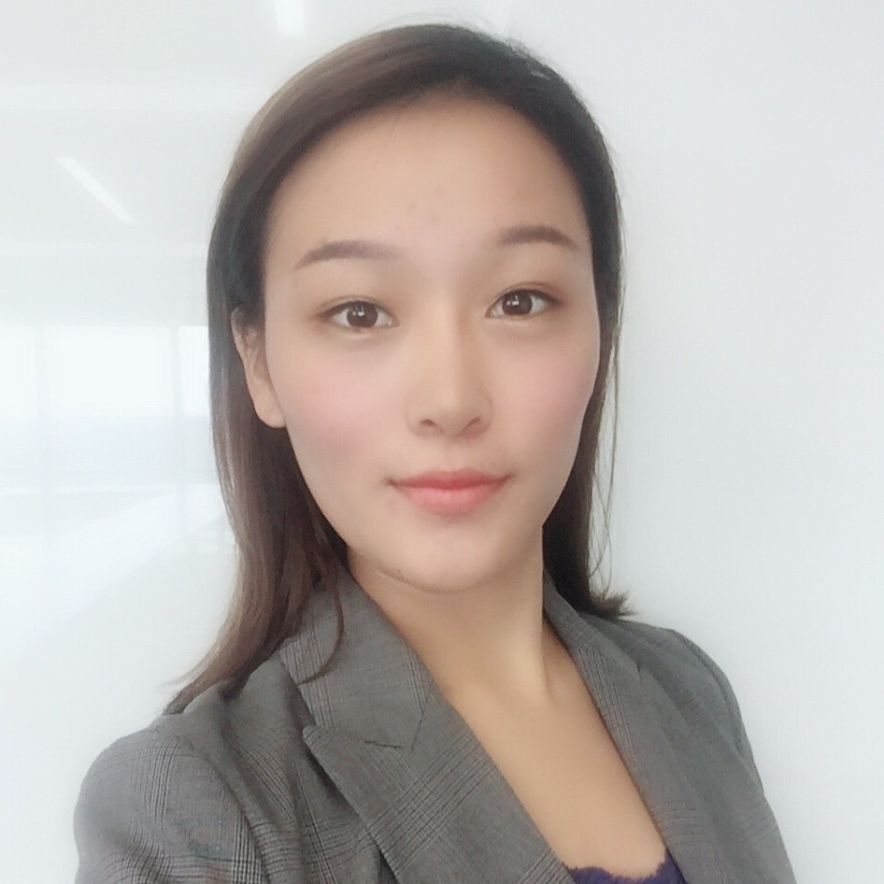
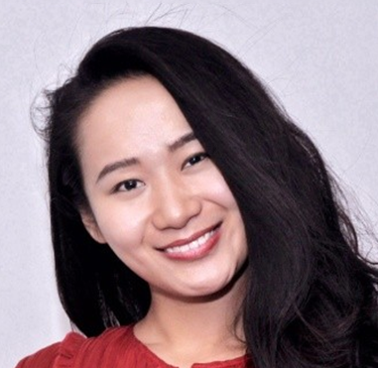
Gloria Pan, 2011
Thunderbird, USA Masters
Aptar China
Mandy Tao, 2011
Laoniu Brother &Sister Foundation
Amber Li, 2015
Pace University, USA
MBA
Carina Guo, 2011
Manchester University, UK
Masters
Olivia Liu, 2011
Yale Center Beijing
HI-COM ASIA Shanghai
Kang Kang, 2012
Nielsen Shanghai

Slide 13
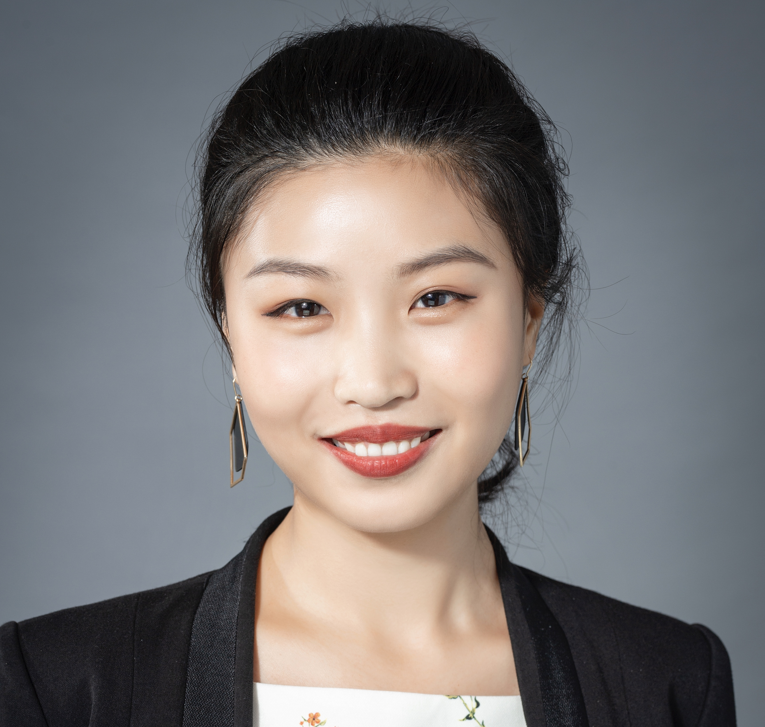
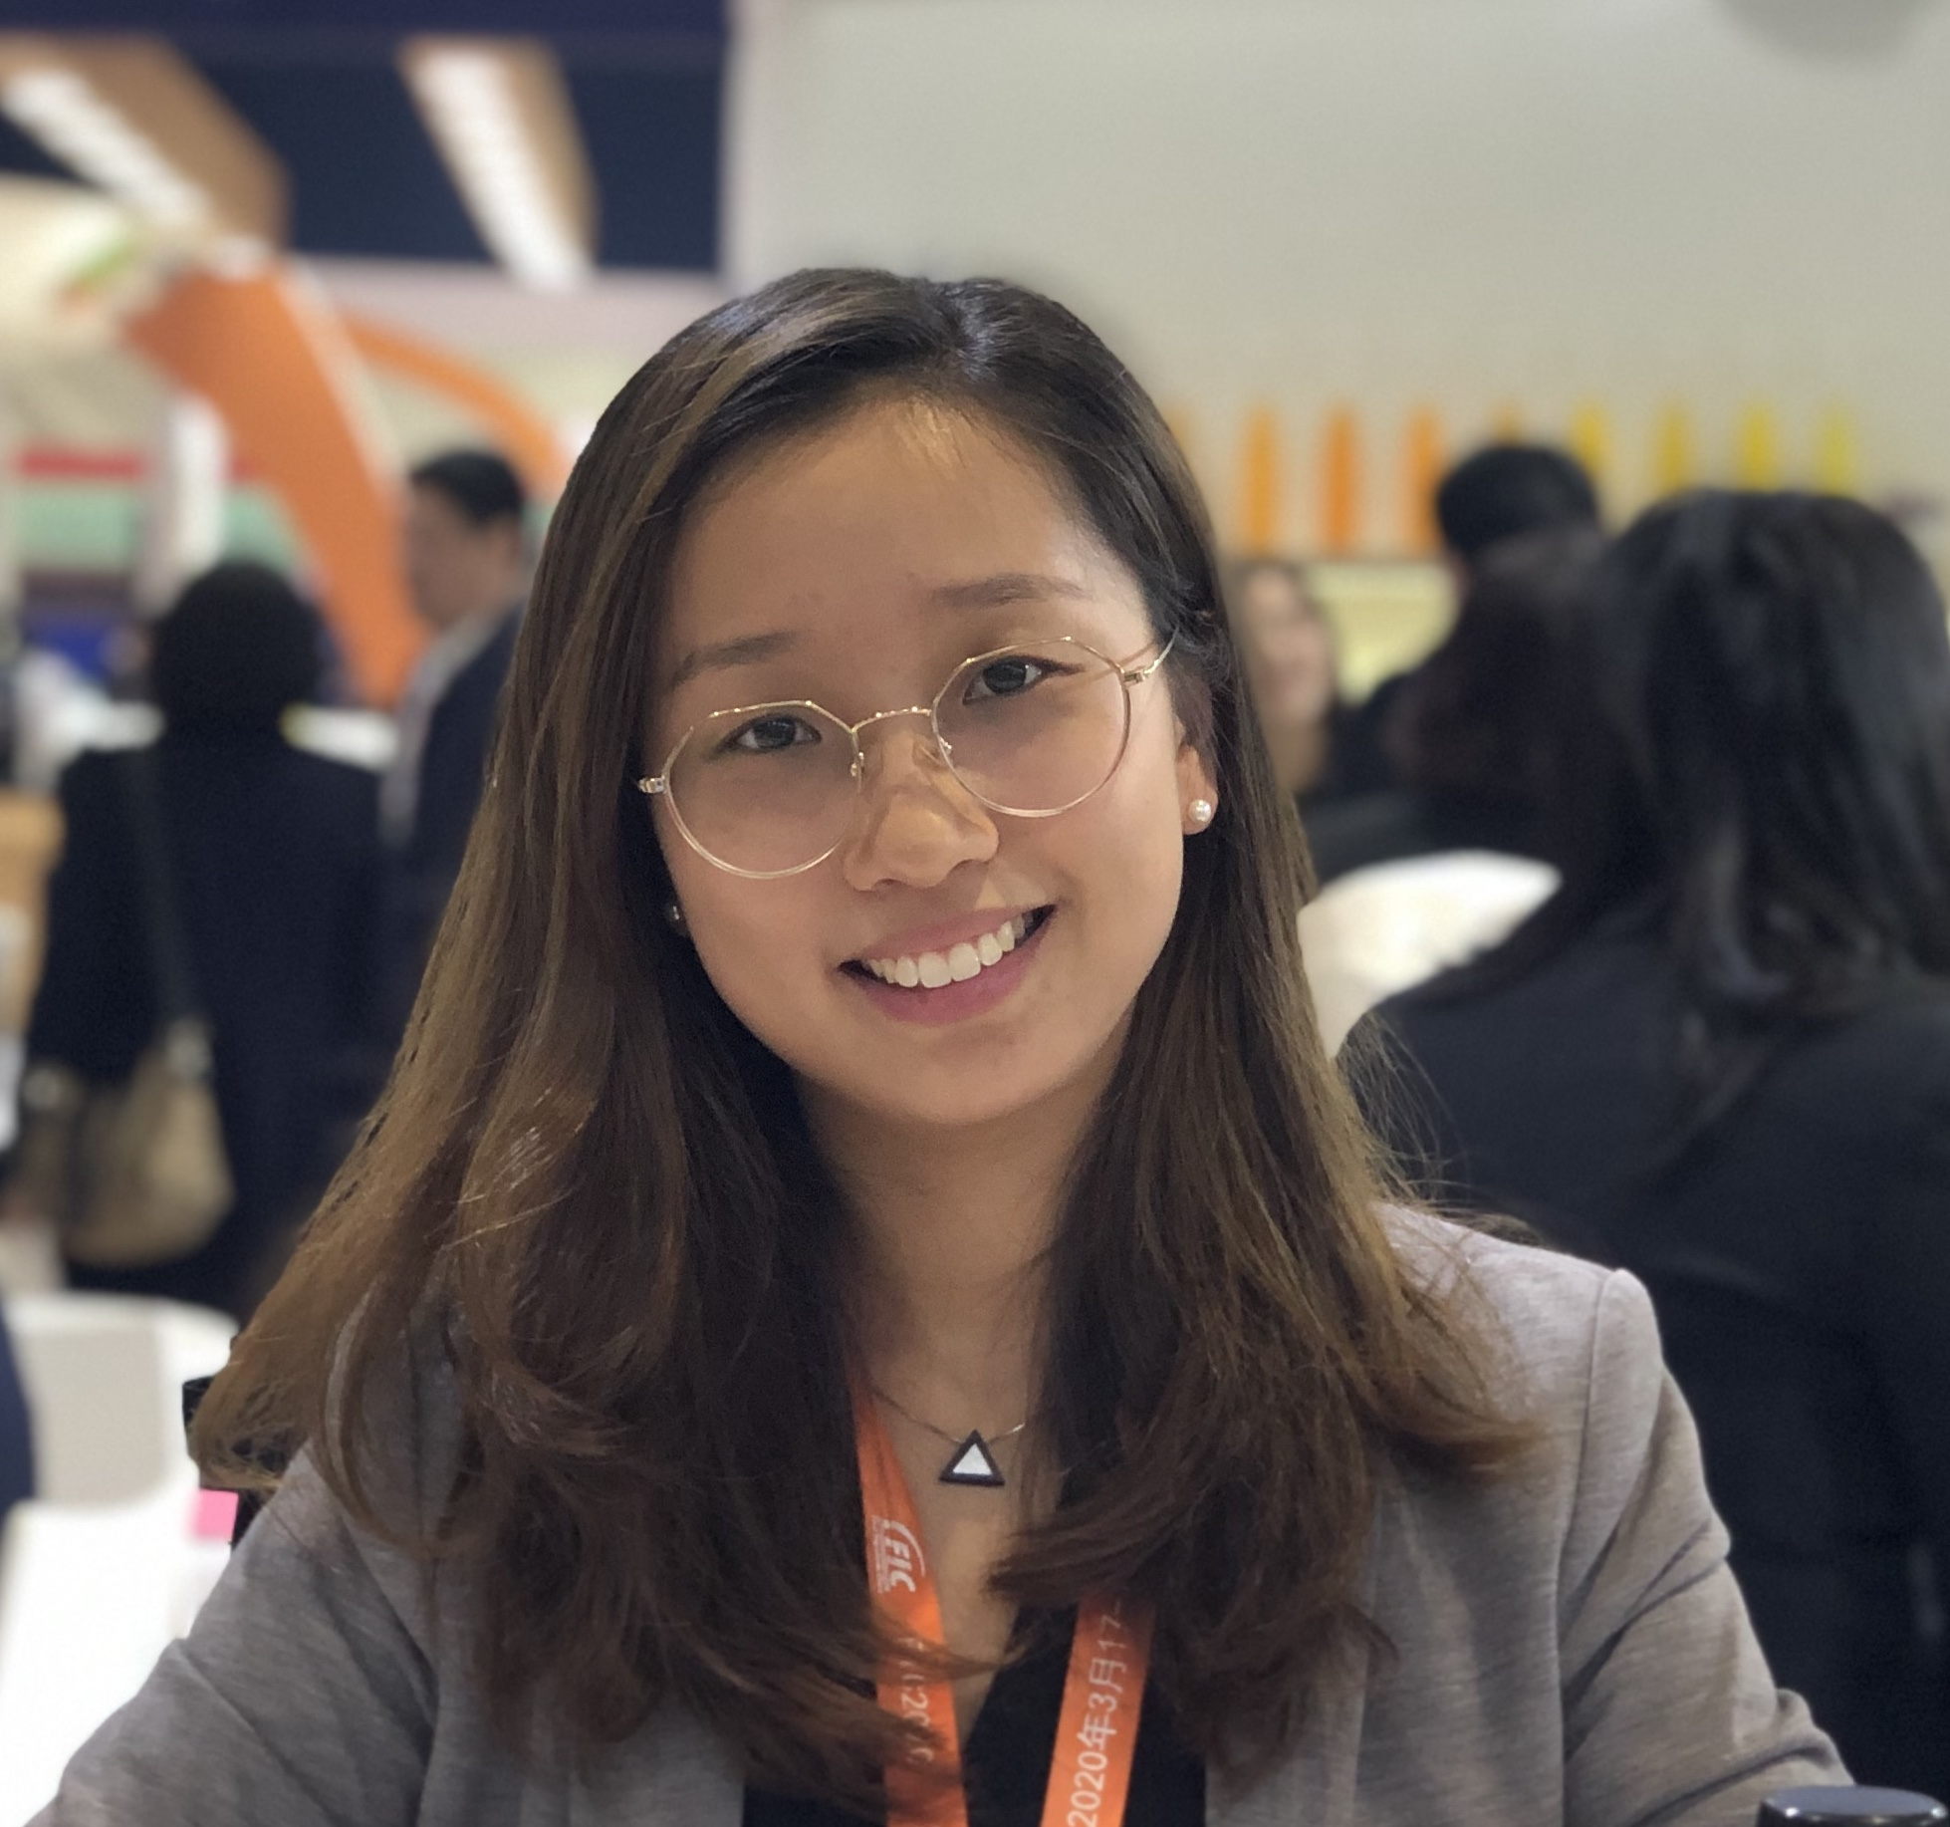
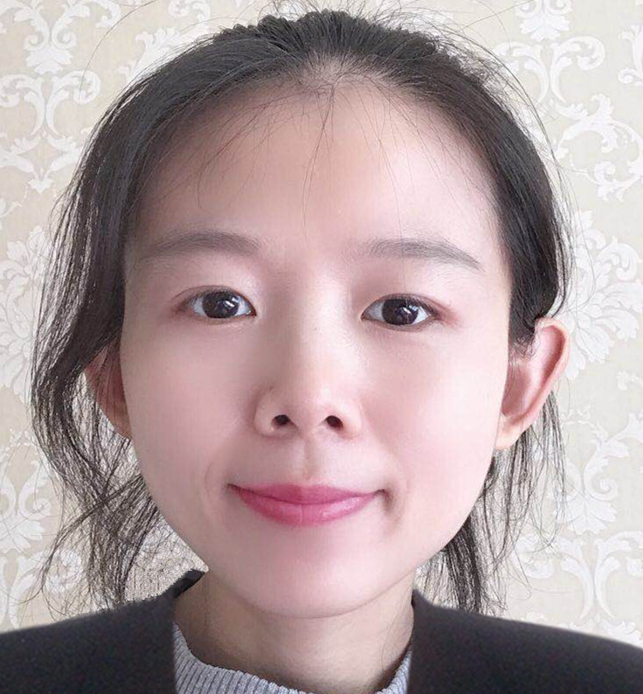
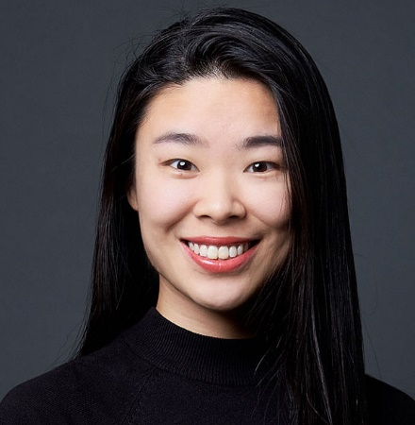
Cecilia Zhang, 2012
Hydrocolloids Business Unit of Royal DSM Shanghai
Juno Liu, 2012
CPIC Allianz Health Insurance Company Shanghai
Annie Chang, 2010
Henan Ancai Hi-Tech Co., Ltd. (China) Business Manager of Overseas Department
Catherine Chen, 2011
GBSB Global Business School and Universität Central de Catalunya, Spain
Masters
Susanna Ma, 2011
Founder of G0ttago
Global Shaper - World Economic Forum in 2016, Participate in the U.S. State Department International Visitor Leadership Program in 2017
Notes:
Need flipchart or white board to capture ideas.

Slide 14
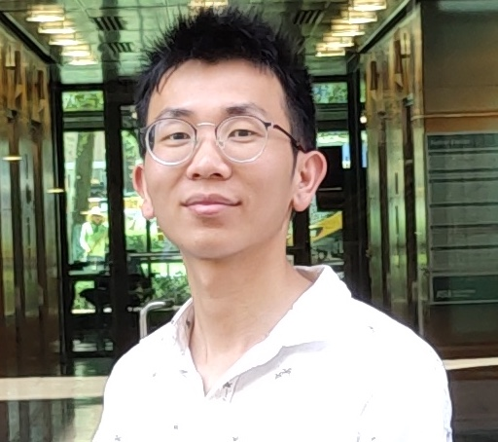
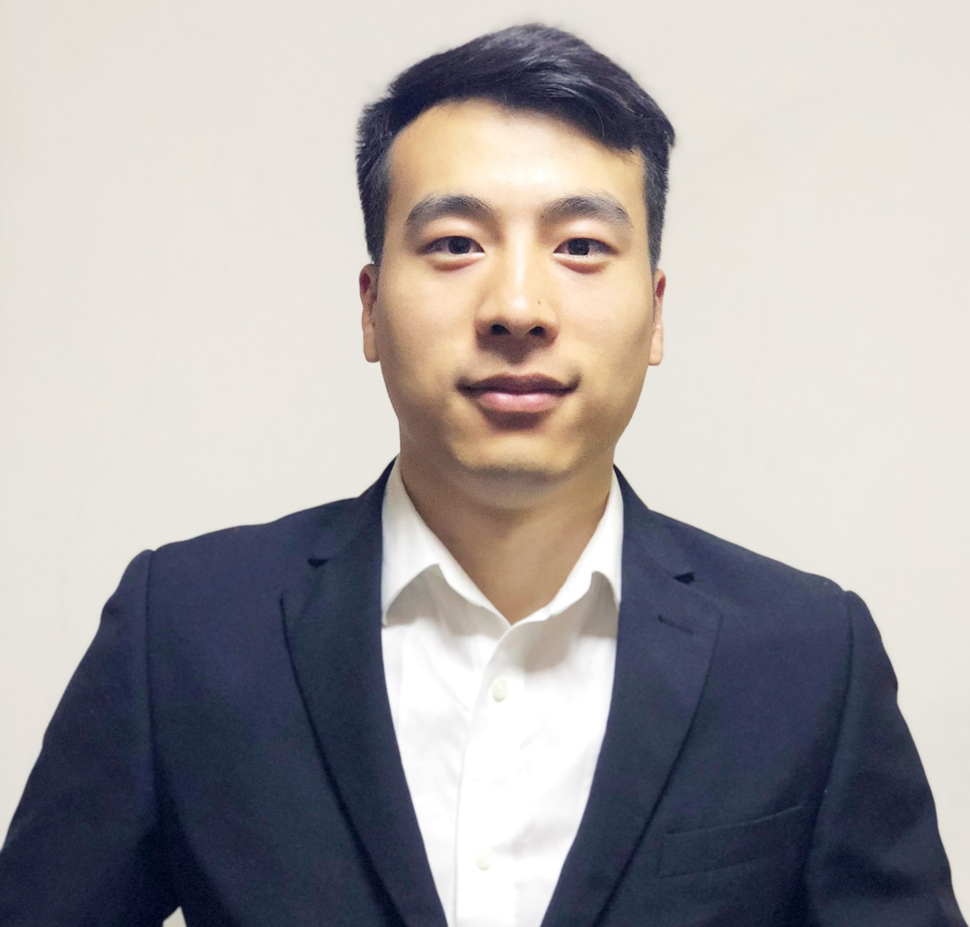
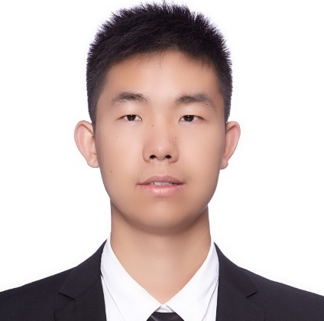
Peter Peng, 2011
Brown Technology Services Jiaxing Co., LTD.
Jason Wang, 2013
Beach Creative Technology Shanghai
Shawn Yu, 2011
The Hong Kong and Shanghai Banking Corporation Limited
Rita Tamang, Nepal 2016
Escaped village to avoid child marriage
Study in Masters at United Arab Emirates
Jasmin Maharjan, Nepal 2016 International Exchange Student at Sias, 2017
Notes:
Jasmin Maharjan, 2016 International Exchange Student at Sias

Slide 15
WAFW Facilitators

Slide 16
2000 – 2015 UN Millennium Goals
Not One Country Achieved One Goal
2015 – 2030 UN Sustainable Development Goals

Slide 17
WAFW Projects
The Projects enable the Academy members to use:
Put their knowledge and skills in action
Express their passion and achieve results
Identify strengths and weakness in their leadership
Recruit, organize and manage a team
Recognize the difference they can make
Have a profound experience of contribution and gratitude

Slide 18
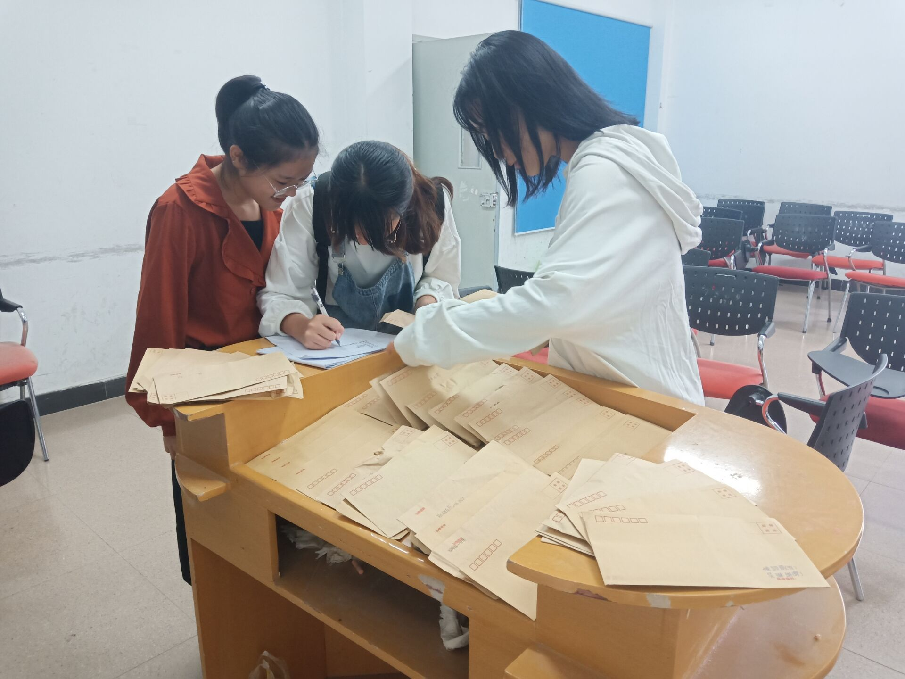
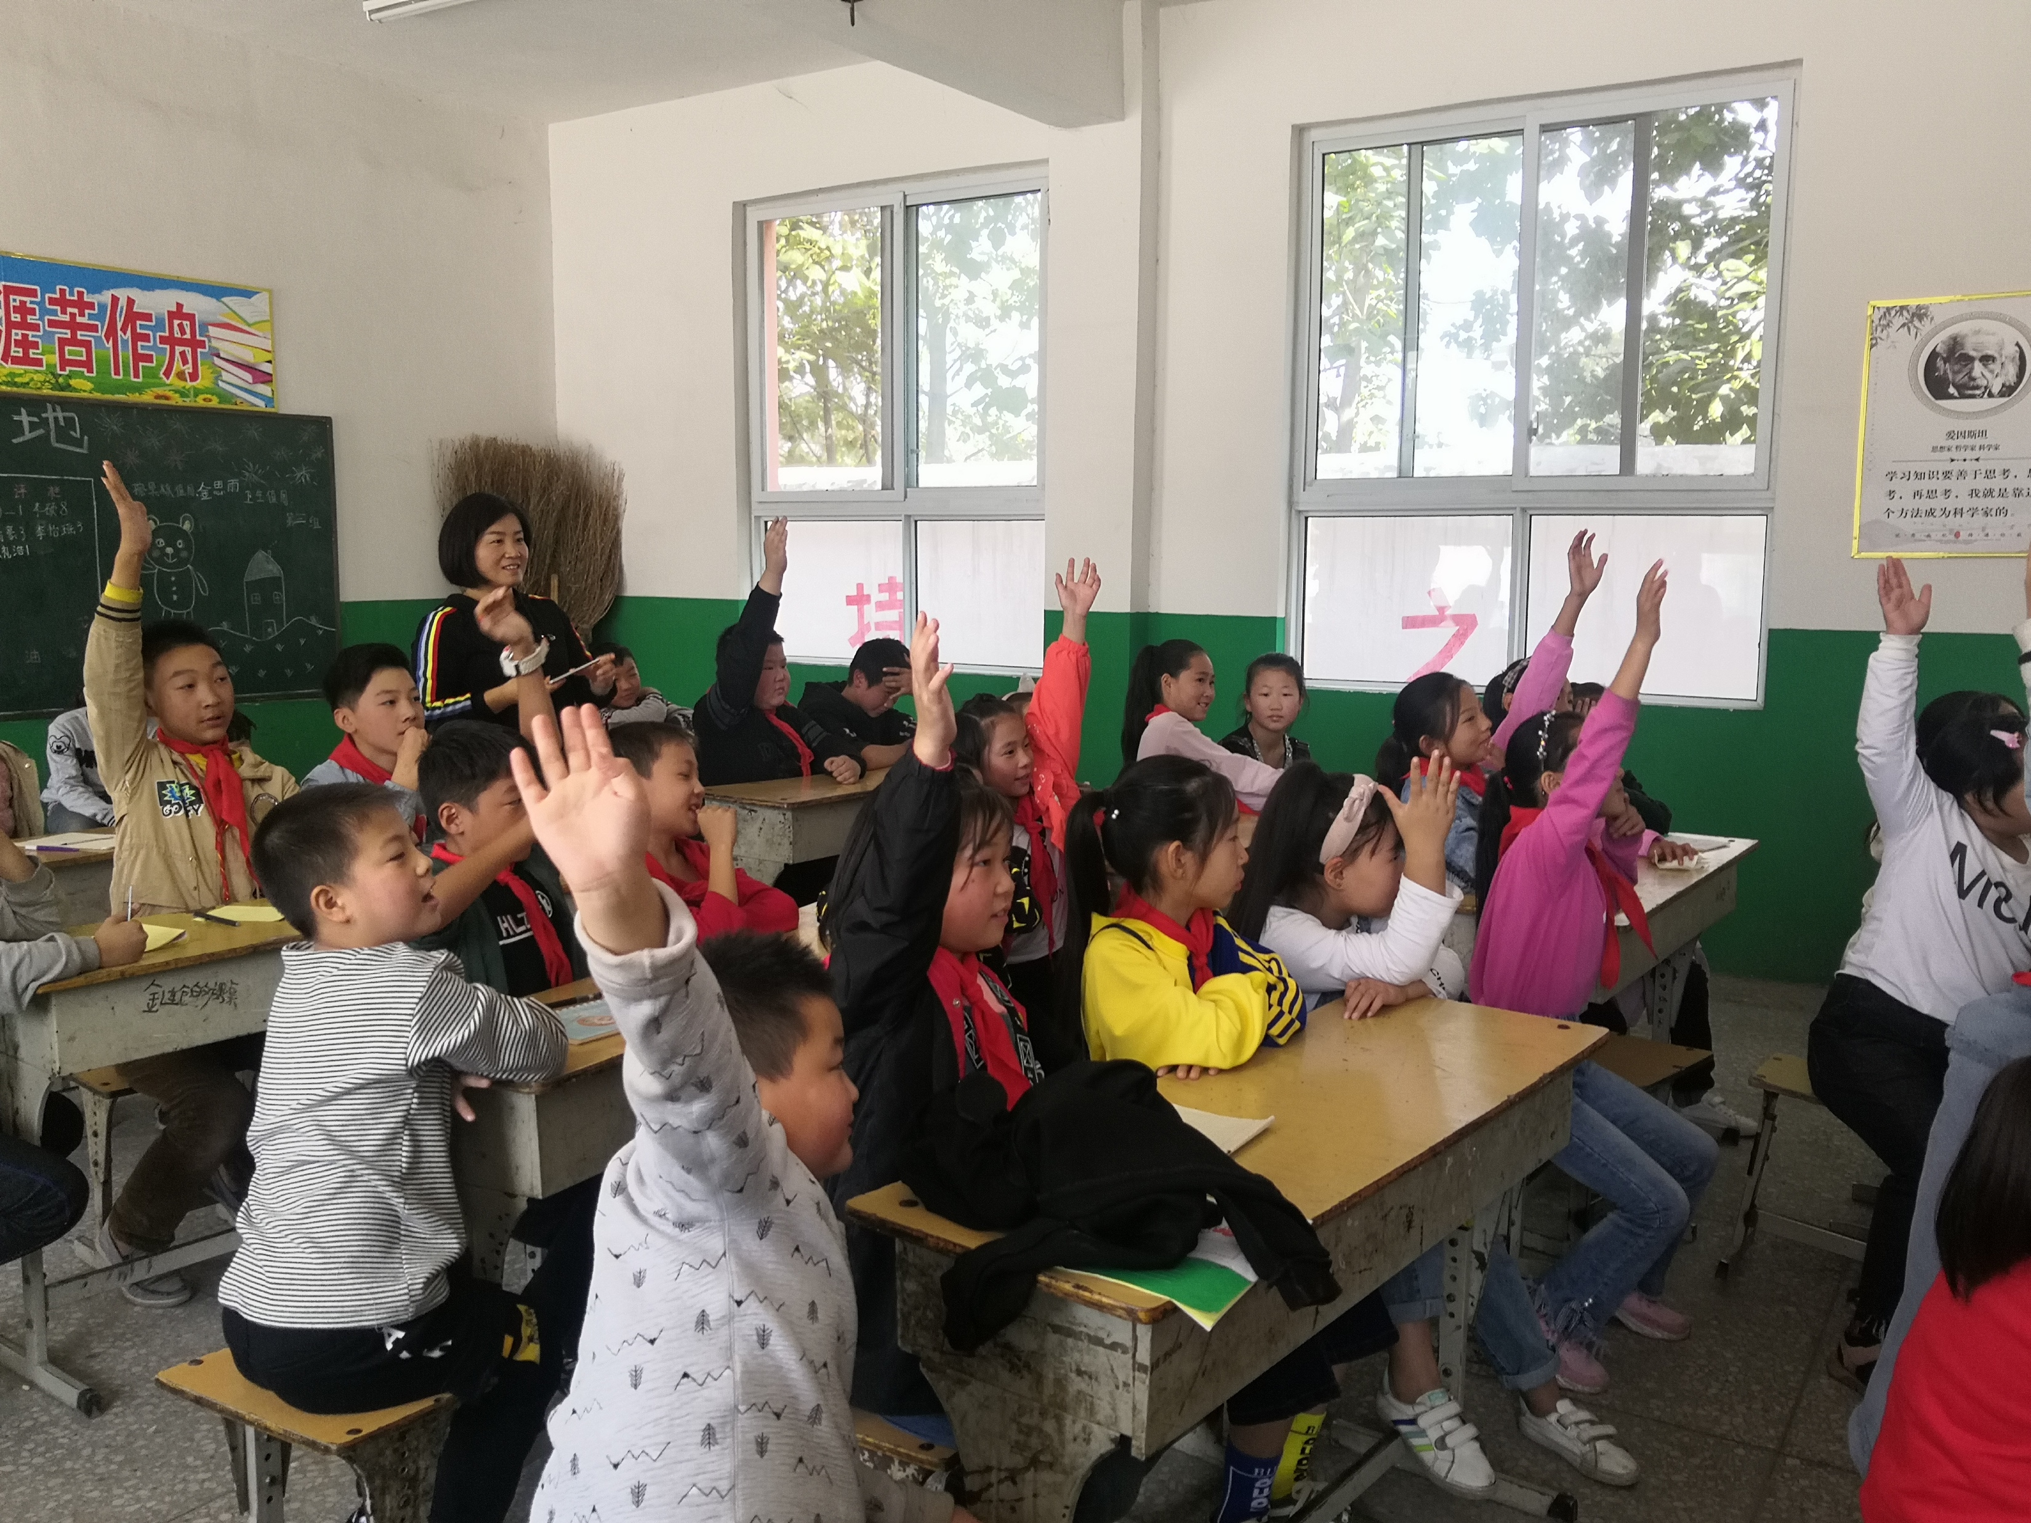
WAFW Projects
Sunshine Angels
To promote the educational and social development of children with disabilities.
One to One
To match university students with children who have been left-behind in their villages with grandparents or in a residential school when their parents have left their villages to work in other cities or provinces.
Leaders of Tomorrow
To create enriching educational experiences for children attending migrant schools.

Slide 19
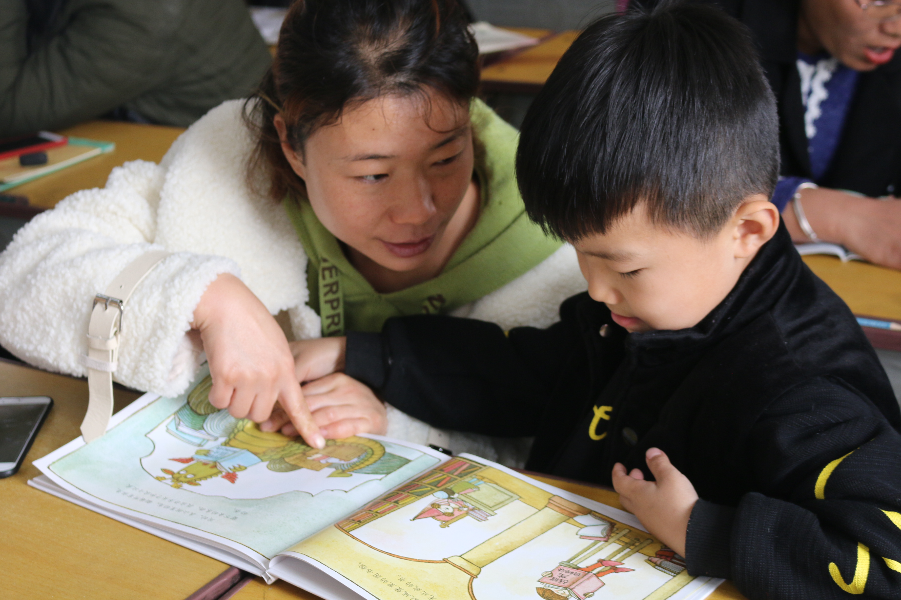
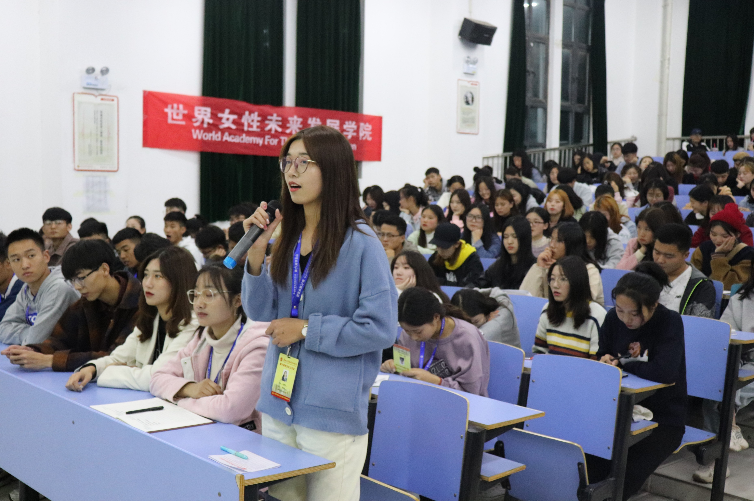
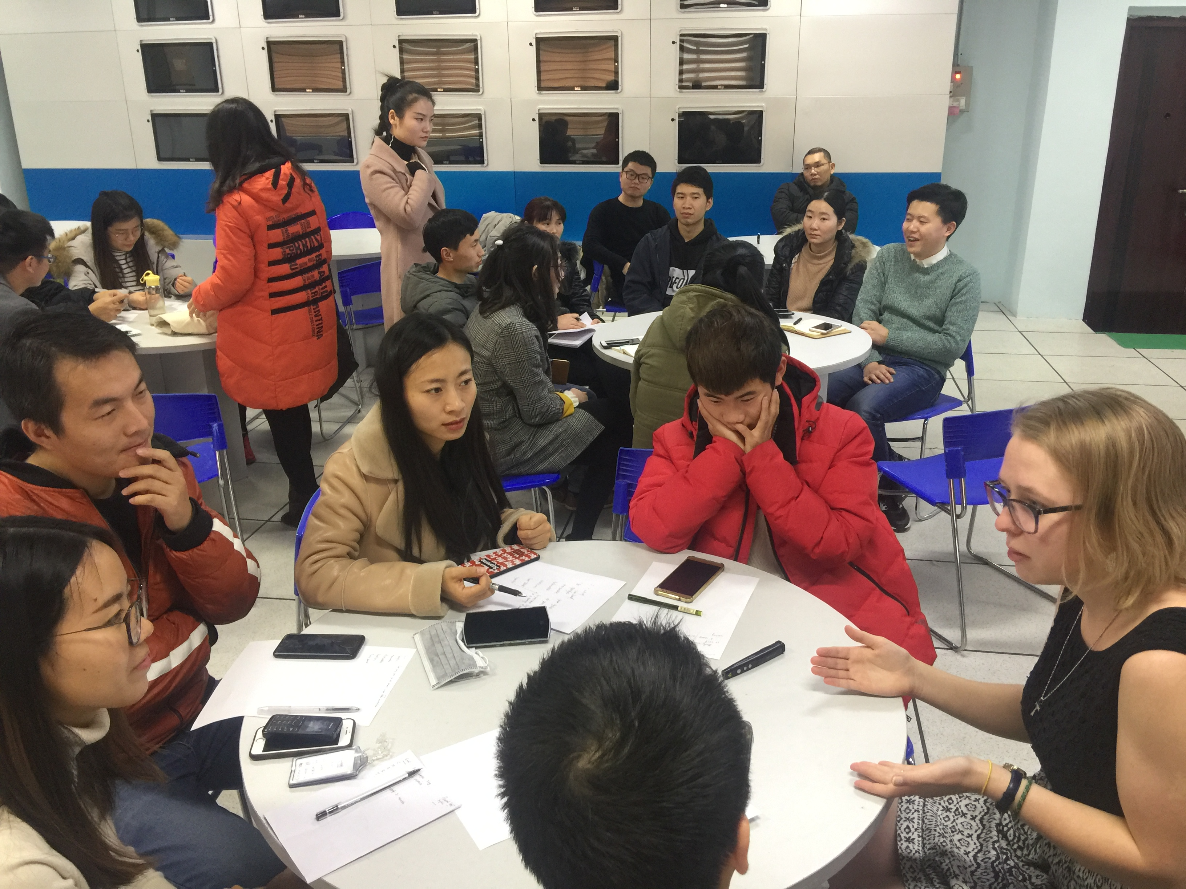
WAFW Projects
Literacy Project
To engage and train parents to read to, and with their children to accelerate their learning, and accelerate love for learning.
Give Voice to Women
For women to advocate for their dreams and achieve equality in their home, community, and workplace.
Continuing Learning
To encourage young women workers at Foxconn to continue learning, discover their dreams, and open their eyes to realize they have endless possibilities in life.

Slide 20
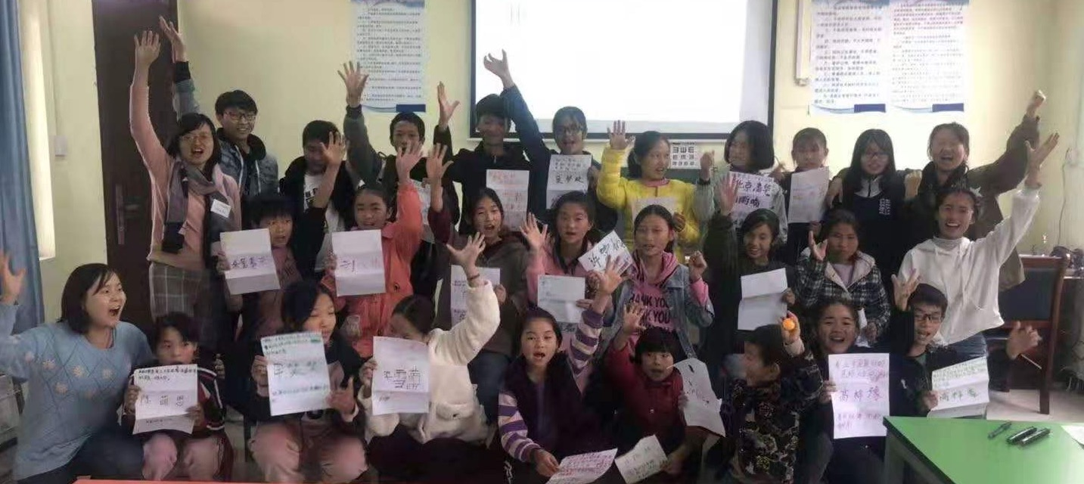
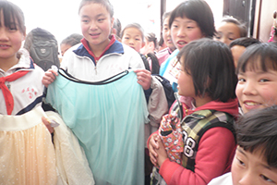
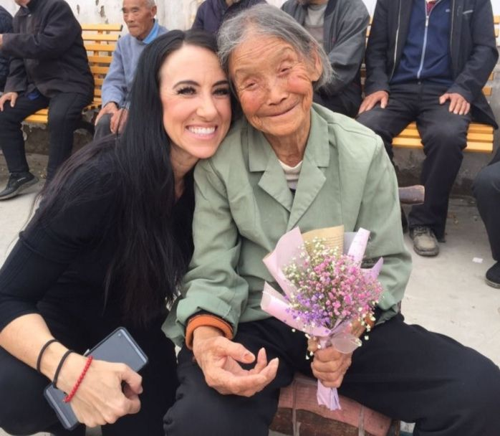
WAFW Projects
HIV/AIDS
To focus on eradicating HIV/AIDS and create awareness for the public to learn and understand about HIV/AIDS. Engage with HIV orphans to enhance their education.
Warm Hearts
To collect clothes and donate them to children without warm clothing so they can attend school in winter.
Nourishing Life
To eradicate extreme poverty and hunger by finding community members who need focus or clothing.

Slide 21
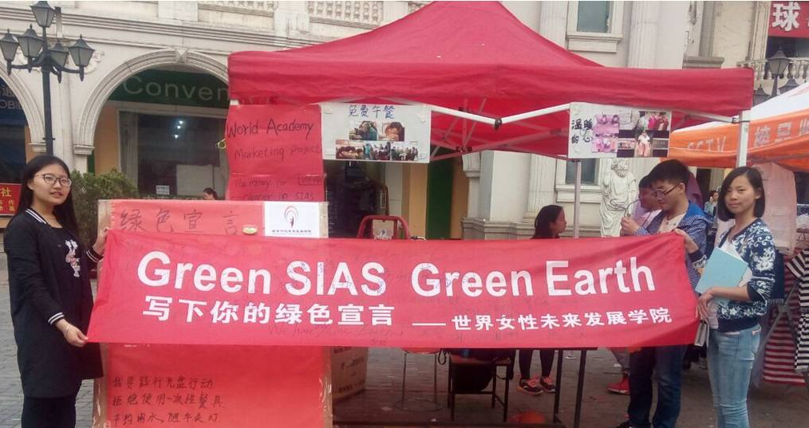
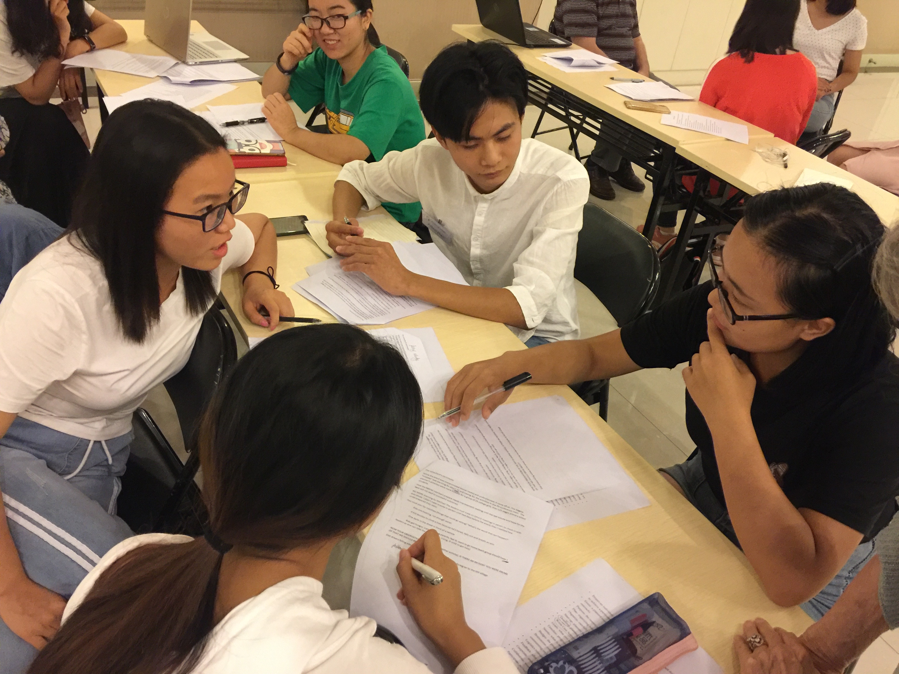
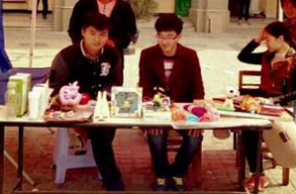
WAFW Projects
Green Sias
To educate students, faculty and the local community members about environmental issues.
Big Bang Thinking
To solve problems for all the projects in the World Academy and create new ones.
Taking Care of Business
To teach the value and necessity of generating money to support program growth.

Slide 22
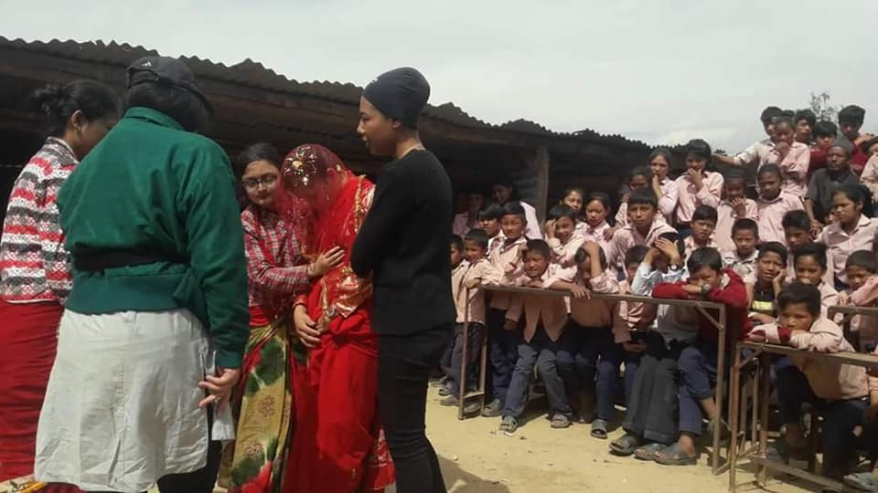
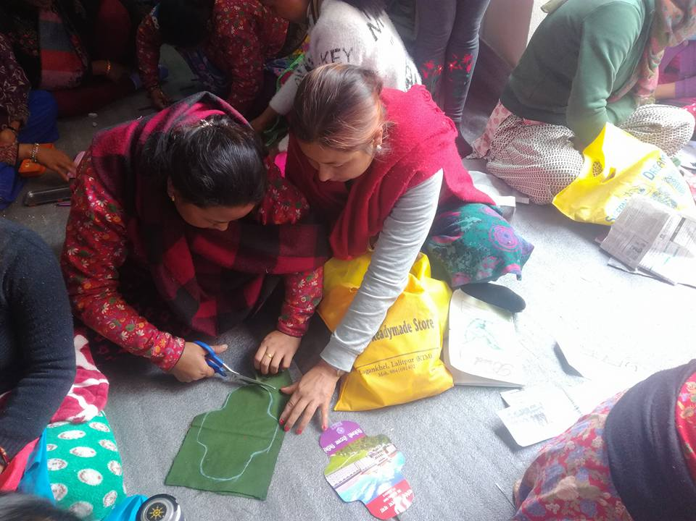
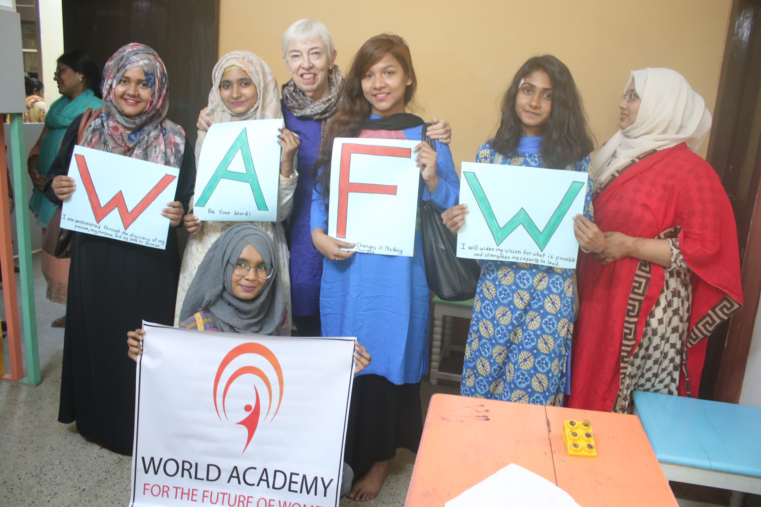
WAFW Projects
No More Child Brides
To end family arranged child marriages.
Menstrual Shame
To end families sending women to outdoor sheds/barns during their menstrual period.
To understand menstruation as a normal female phenomenon.
Domestic Violence
End beating and raping girl children and wives by family members promote conversations and education.

Slide 23
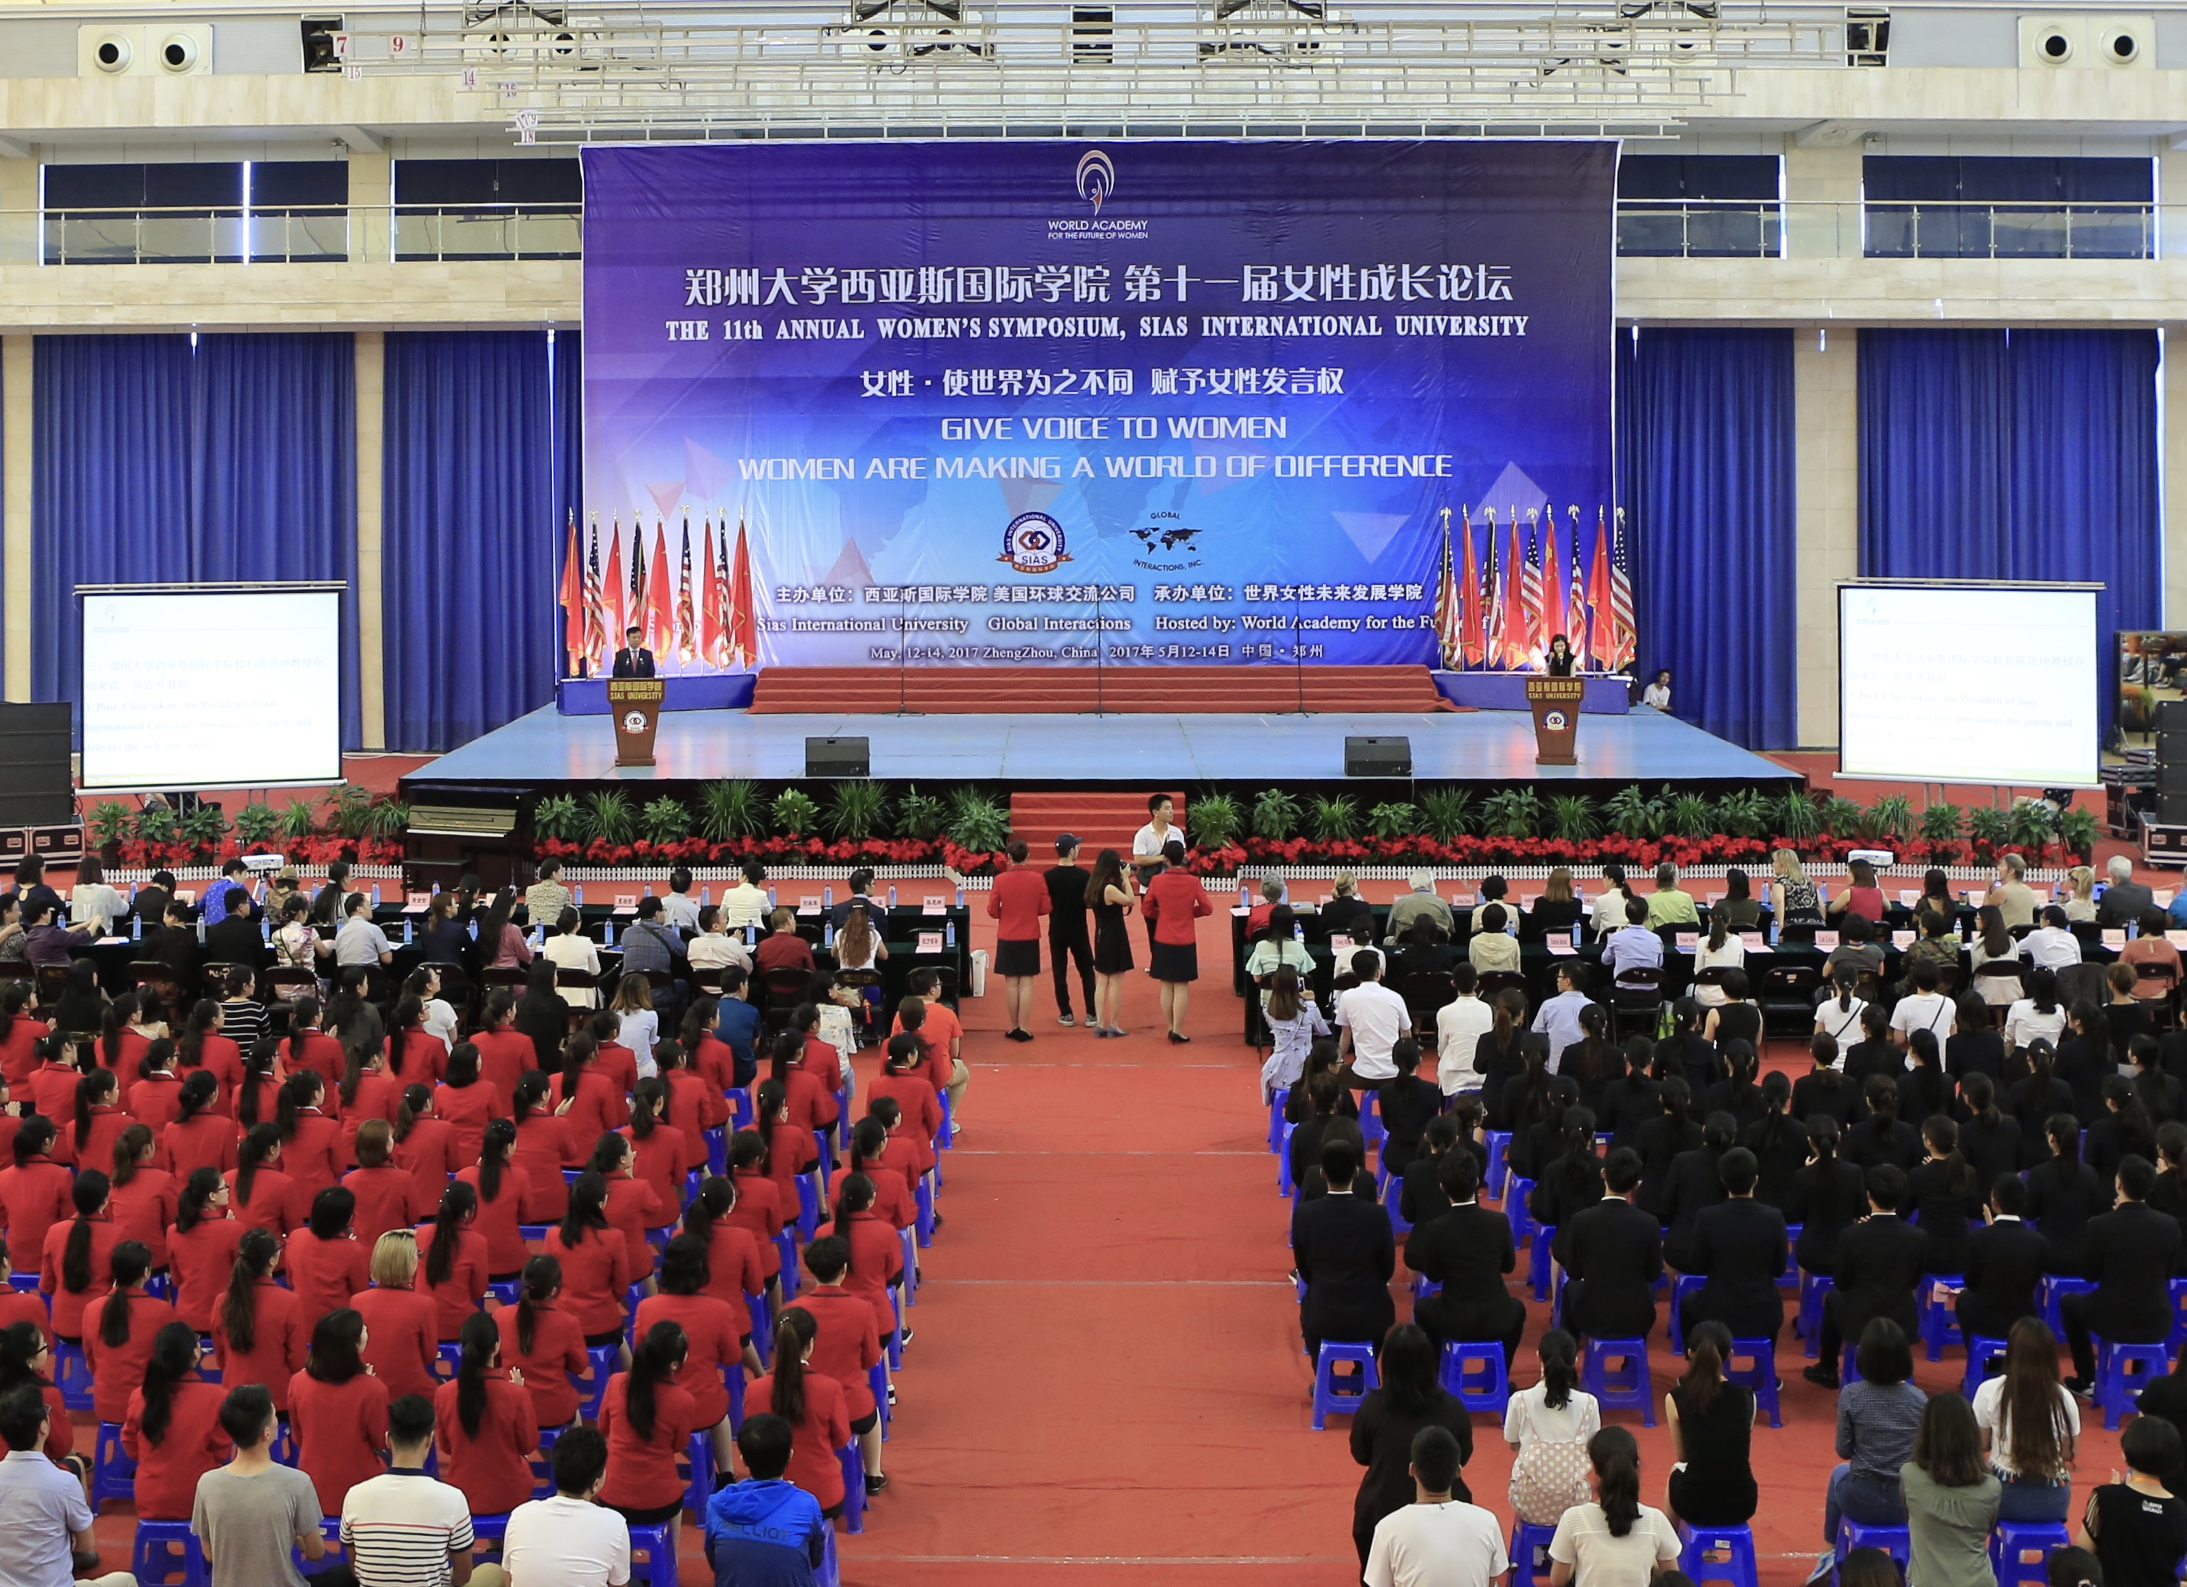
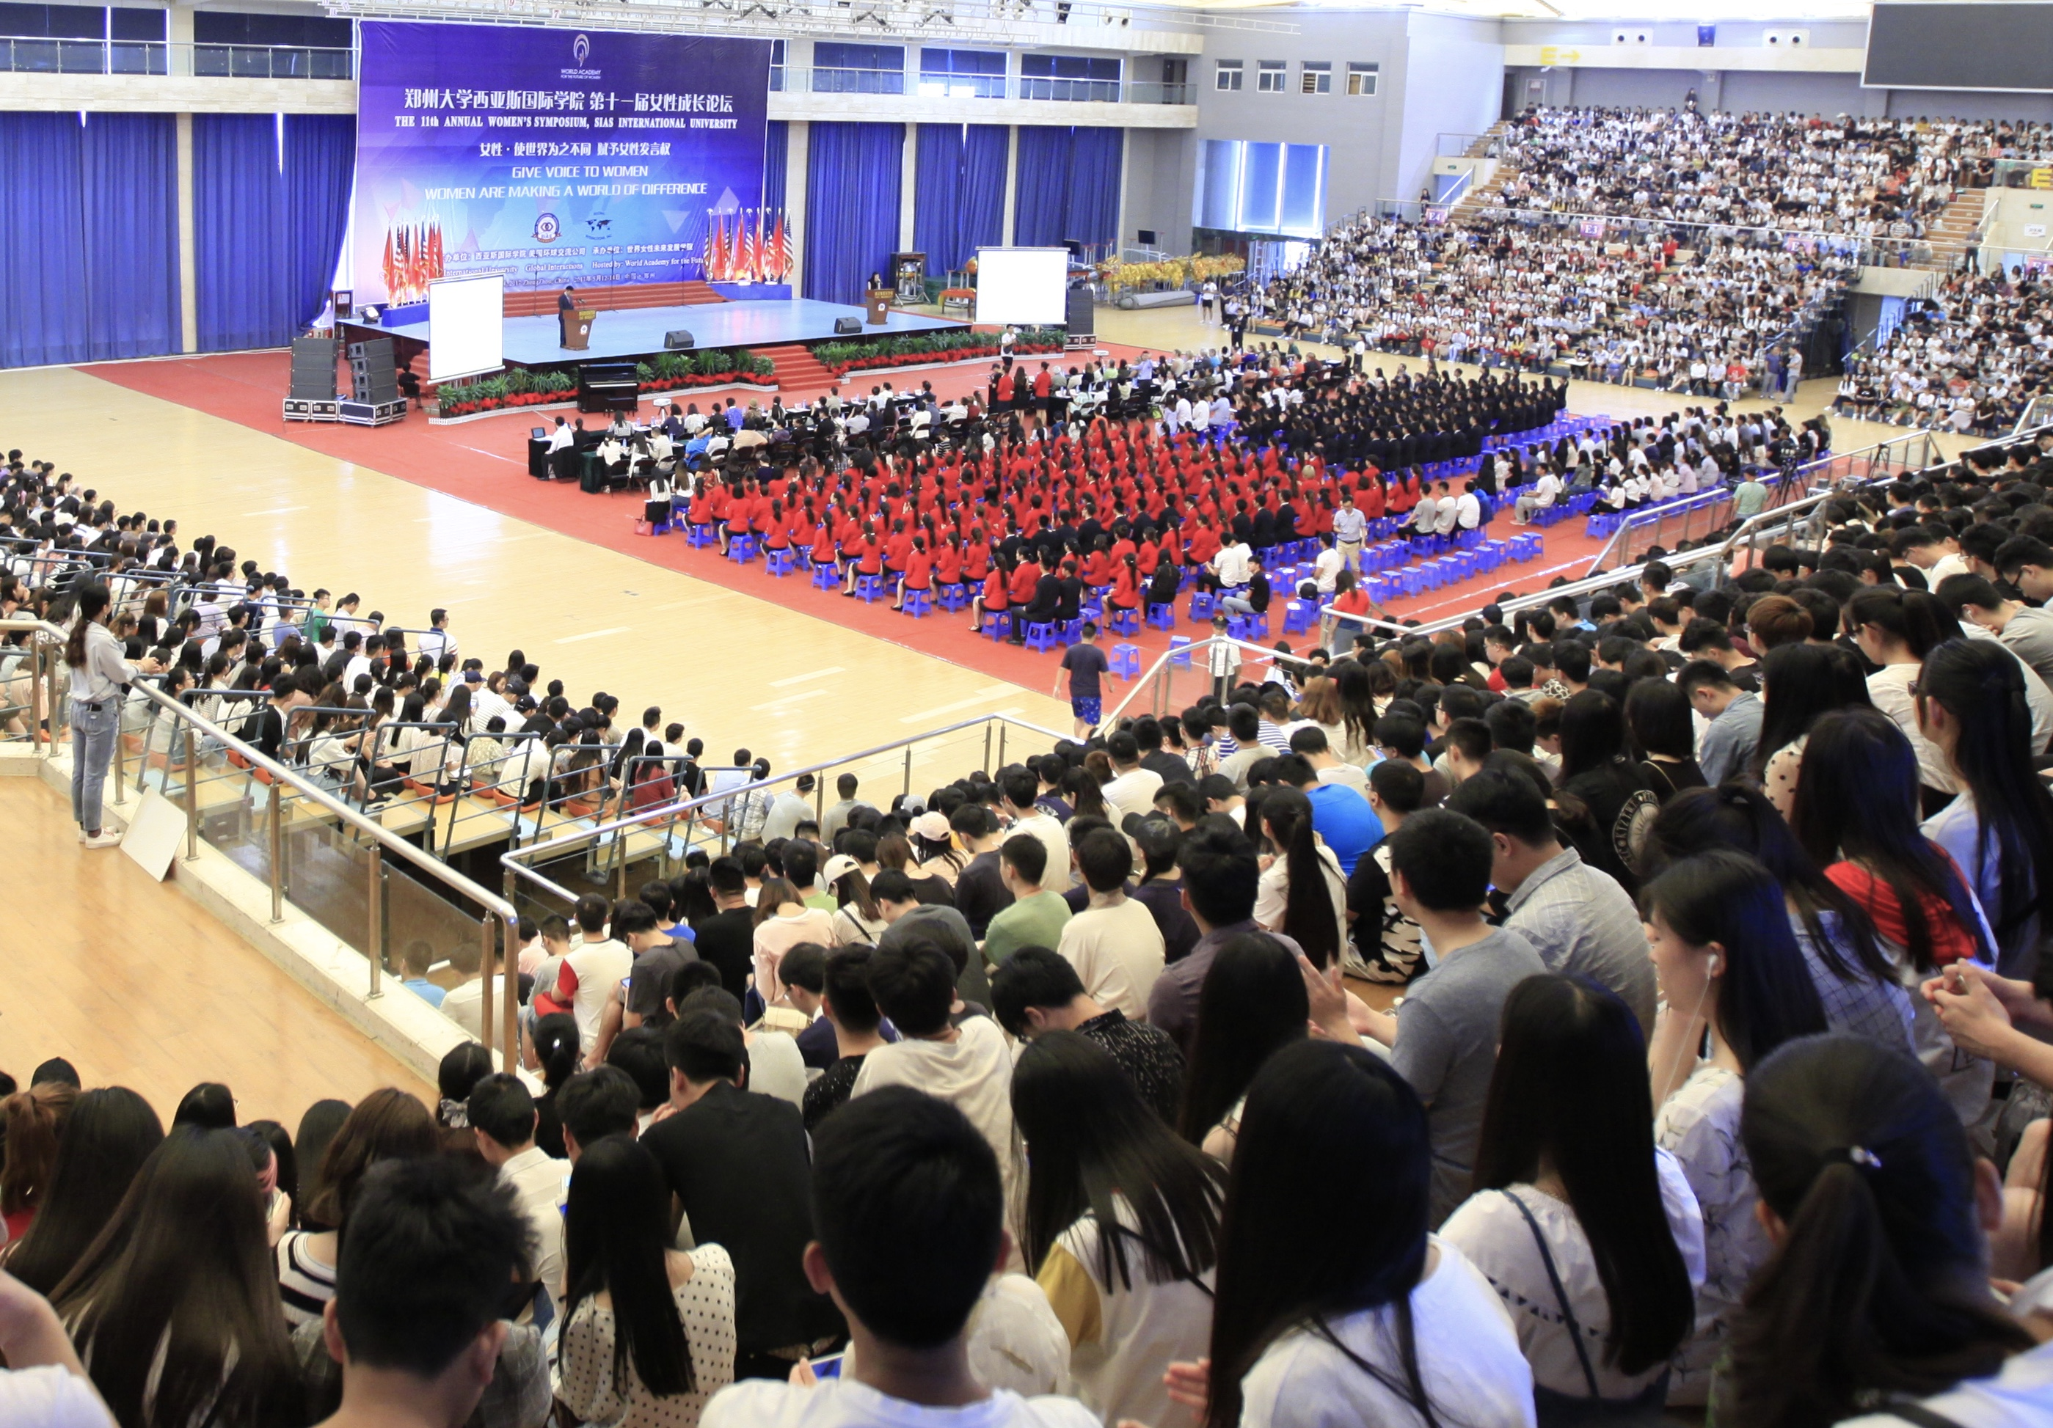
Annual Women’s Symposium Organized by WAFW
The purpose of the Symposium is to inspire university women to discover the importance of leadership and to encourage them to see themselves as women who can contribute to their communities and can make a meaning contribution through their work.

Slide 24
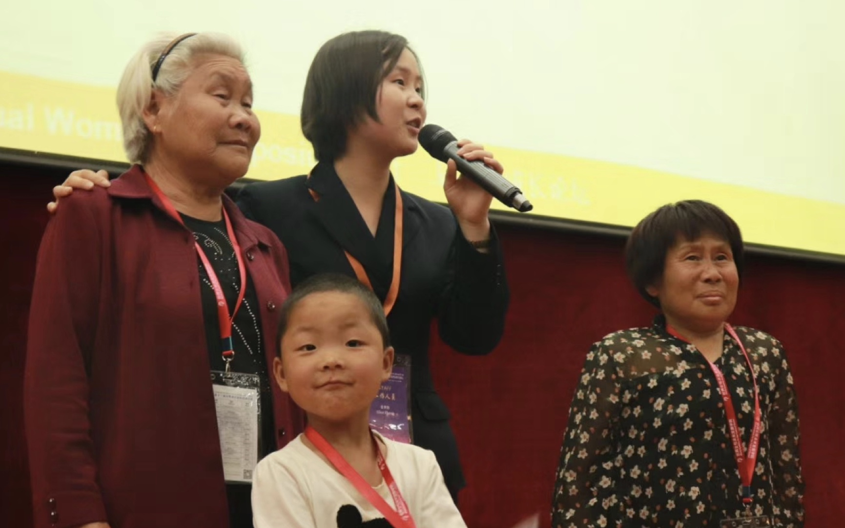
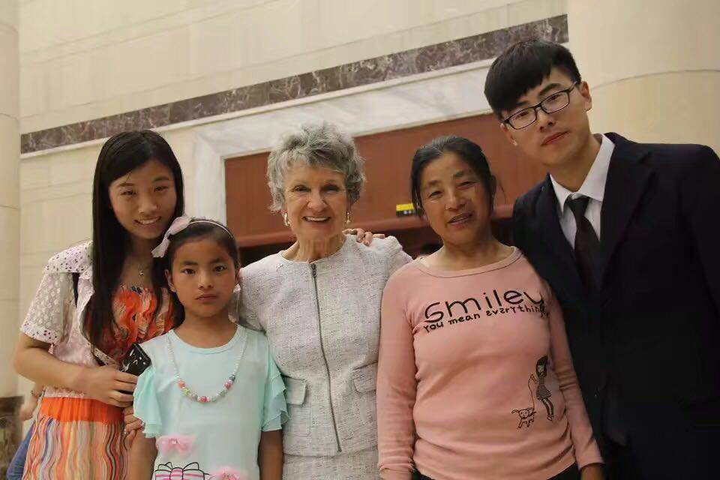
Honoring Mother’s Reception An event to celebrate and acknowledge mothers for their support to continue education and leadership

Slide 25
World Academy Partners and Sponsors
Collaborative partnerships are essential to accelerate and achieve the United Nations Sustainable Goals.
Meaningful dialogue and actions
Mutually beneficial to our results
Connecting Academy members and Academy projects to communities, individuals and groups
Internships, scholarships and jobs
Mentorships, support and new possibilities

Slide 26
WAFW Partners and Sponsors
25

Slide 27
Possibilities For Creating A Future
What’s Next?

